Slide 1
Interdisciplinary Strategies for BRCA-Mutated EBC: Testing, Targeting, and Team-Based Care

Slide 2
DISCLAIMER
This slide deck in its original and unaltered format is for educational purposes and is current as of December 2025. All materials contained herein reflect the views of the faculty, and not those of AXIS Medical Education, the CME provider, or the commercial supporter. Participants have an implied responsibility to use the newly acquired information to enhance patient outcomes and their own professional development. The information presented in this activity is not meant to serve as a guideline for patient management. Any procedures, medications, or other courses of diagnosis or treatment discussed or suggested in this activity should not be used by clinicians without evaluation of their patients’conditions and possible contraindications and/or dangers in use, review of any applicable manufacturer’s product information, and comparison with recommendations of other authorities.

Slide 3
DISCLOSURE OF UNLABELED USE
This activity may contain discussion of published and/or investigational uses of agents that are not indicated by the FDA. The planners of this activity do not recommend the use of any agent outside of the labeled indications.
The opinions expressed in the activity are those of the faculty and do not necessarily represent the views of the planners. Please refer to the official prescribing information for each product for discussion of approved indications, contraindications, and warnings.
USAGE RIGHTS
This slide deck is provided for educational purposes and individual slides may be
used for personal, non-commercial presentations only if the content and references
remain unchanged. No part of this slide deck may be published in print or
electronically as a promotional or certified educational activity without prior written
permission from AXIS. Additional terms may apply. See Terms of Service on
www.axismeded.com for details.

Slide 4
Learning Objectives
Upon completion of this activity, participants should be better able to:
Apply guideline-directed genetic and biomarker testing to inform personalized treatment planning in high-risk early-stage breast cancer (EBC)
Evaluate current guidelines and pivotal clinical data to inform evidence-based treatment decisions for patients with high-risk BRCA-mutated EBC
Select evidence-based treatment approaches for patients with high-risk EBC and germline BRCA mutations
Explain best practices for optimizing interdisciplinary team collaboration in the management of patients with high-risk EBC
Recognize and manage treatment-related adverse events, ensuring patients are educated and supported in monitoring and reporting symptoms
Describe key healthcare disparities affecting access to personalized breast cancer care and strategies to improve equity in underserved populations

Slide 5
BRCA Testing in High-Risk EBC: Practical Guidance

Slide 6
NCCN and ASCO-SSO Guidelines on Genetic/BRCA Testing
NCCN Guidelines¹
For localized breast cancer (invasive, non-inflammatory, M0), genetic counseling and testing if patient is at risk for hereditary breast cancer, has TNBC (at any stage), or is a candidate for adjuvant olaparib
ASCO-SSO Guidelines²
BRCA1/2 mutation testing should be offered to all newly diagnosed patients with breast cancer ≤65 years and select patients >65 years based on personal history, family history, ancestry, or eligibility for PARP inhibitor therapy
Notes:
So, the NCCN guidelines suggest that for localized breast cancer, and that's patients who have invasive, non-inflammatory, non-metastatic breast cancer, genetic counseling and testing in the patient’s at risk for hereditary breast cancer is important. This is particularly critical for patients with any stage of triple-negative breast cancer or if they might be a candidate for adjuvant olaparib. And we'll talk more about who is a candidate for adjuvant olaparib, but this often encompasses most of our patients who have ER-positive breast cancer and almost anyone with triple-negative disease.
And then, ASCO and SSO take it a little bit further and they say BRCA mutational testing should be offered to all newly diagnosed patients with breast cancer under 65 and then select patients over 65 based on personal history, family history, and eligibility for PARP inhibitor therapy. And I do agree with those sort of broader ASCO guidelines. I think, this testing and these test results can make a difference for almost any patient. And, knowledge is power and knowing about it, even if it doesn't directly affect exactly what you're going to do from a breast cancer treatment standpoint, might be useful for understanding your own cancer risk going forward, and certainly for impacting and helping your family. So, these are just some things to keep in mind as you think to yourself about which of my patients might be eligible for germline mutational testing.

Slide 7
Real-World Germline BRCA Testing Rates in EBC
A total of 2373 US patients diagnosed with HER2- EBC (stage I-III) between January 1, 2021, and February 29, 2024
Less than half (48%) of patients received a gBRCA test
Lower testing rate in patients with HR+/HER2- EBC (n=905/2040, 44%) than in those with TNBC (n=242/333, 73%)
A substantial proportion of patients eligible for gBRCA testing, including those ≤50 years (n=117/417, 28%), with high-risk HR+/HER2- EBC (n=44/103, 43%) or with high-risk TNBC (n=20/87, 23%) had unknown/untested status
Notes:
In the real world, how are we doing with this? So, a total of 2,373 U.S. patients who were diagnosed with HER2-negative early breast cancer between January 2021 and February 2024 were studied, so three years of following this patient population. What was found was that less than half of these patients received a germline BRCA test. There were lower testing rates in patients with hormone-positive disease than triple-negative disease. About 44% of the hormone-positive patients were tested and 73% of the triple-negative. And a substantial portion of patients who had been eligible, including those less than 50 years old, who had high-risk hormone positive early breast cancer, or those with high-risk triple negative breast cancer, had unknown or untested status.
This is an abstract that was presented at San Antonio in 2024. While, of course, this is just a small subset of the US population, it speaks to the fact that we don't have the uptake we would like to be seeing in terms of germline testing for these patients.

Slide 8
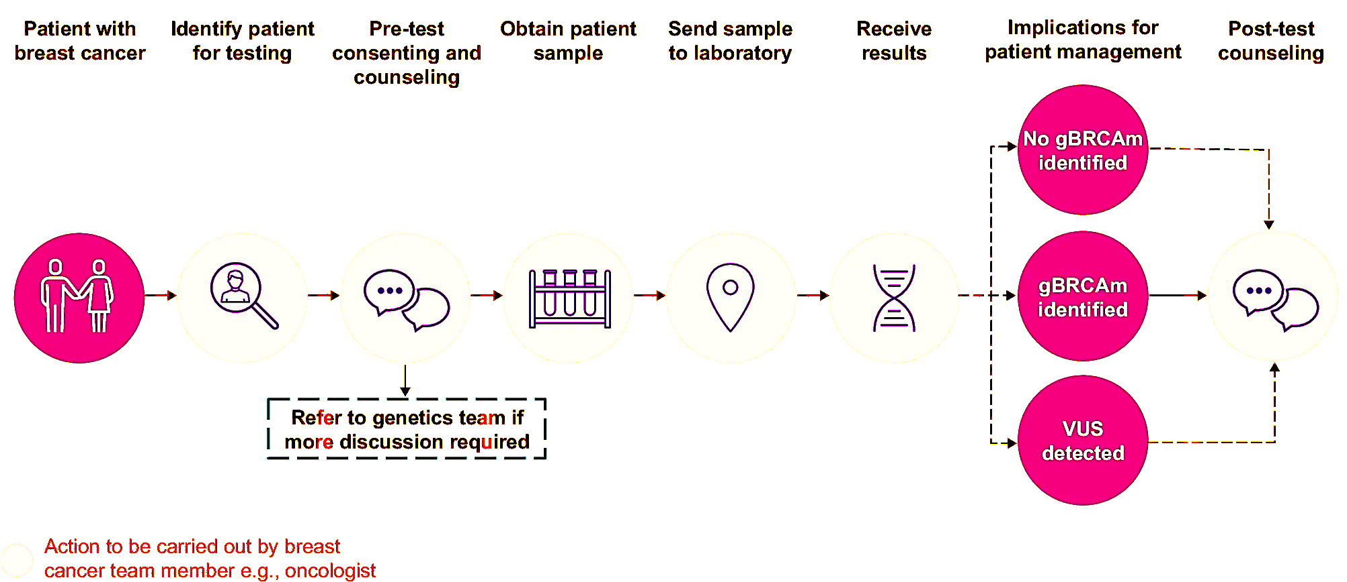
Point-of-Care Germline BRCA Testing Is Feasible
Notes:
So, what are some of the problems behind this? We'll talk more about this, but I think some of it is that we aren't always doing this in our own clinical practices. It can be hard to get patients in with genetic counselors, and therefore patients sometimes don't do just that one more thing if they're already needing to have surgery and think about chemo and anti-estrogen therapy, so sometimes it's just not feasible to make it to a genetic counselor. And sometimes also we don't have the tools that we need to be able to counsel patients on this.
The point of this slide is that point-of-care germline BRCA testing is feasible. Patients have breast cancer, they come into your clinic, you identify that the patient needs testing, and often as physicians, we are qualified to do the pre-test consenting and counseling for germline testing. We can then obtain a sample, which sometimes is blood, but sometimes can just be a saliva sample, and send the sample to the lab and get the results. And often what we do is we refer the patient to the genetics team if more discussion is required. This kind of takes that bottleneck of seeing the genetic counselor out of the picture. It allows you to get your genetics results early because many patients that you test will be negative and that will be reassuring. But for those who are positive, we are increasingly able to counsel patients on what they need to do from a treatment of the cancer standpoint. And then from a future risk standpoint, that's where bringing a genetic counselor in on a sort of urgent and timely manner, but not so much of an emergency as we've got to get this testing done now, can happen.
So, if no germline BRCA mutation is identified, that's one thing. If you find a germline BRCA mutation, then of course we're going to counsel patients and also send them to genetics. And then if a variant of uncertain significance is detected, then we can often reassure those patients.
But of course, make sure that those patients are then continuing to be followed so that if that variant becomes significant at some time point, we're able to counsel them on what to do.

Slide 9
Genetic Counseling: A Team Approach
A multidisciplinary team may include a genetic counselor, medical oncologist, surgical oncologist, gynecologist, and/or social worker
A multidisciplinary team approach brings together various specialists to deliver coordinated, comprehensive care, working to assess patient risk, determine the need for genetic testing, and guide personalized treatment planning based on the results
With interdisciplinary perspectives, a multidisciplinary team can address unique needs of high-risk EBC patients and families
Notes:
So, a team approach, I think, is key. We all work in multidisciplinary teams. I think breast cancer, you can’t treat this disease alone, and your multidisciplinary team may include a genetic counselor, medical oncologist, surgical oncologist, gynecologist, social worker. Of course, many other people too. I mean, your radiation doctors, your pathologists are all key as part of this, and often your other team members such as cardiology and psychiatry, as well.
So, the multidisciplinary team approach brings together lots of various specialists to deliver this coordinated and comprehensive care. As far as genetics goes, we all are really working together to assess patients' risk, determine the need for genetic testing, and then of course counsel patients about that because patients often will come to the table with certain fears about what they might have inherited, what this might mean for their family, for their insurance, all sorts of things. So, being prepared to talk to patients about all those questions I think is really key.
And with bringing all these different perspectives to the table, the multidisciplinary team can address these needs for patients and make sure that patients get the information that they need to make the best decisions about their care.

Slide 10
Racial Disparities in Breast Cancer Risk Factors and Risk Management
Racial disparities in breast cancer outcomes are well described across the spectrum of screening, diagnosis, treatment, and survivorship
Screening strategies should be both risk- and race-based, given the prevalence of early-onset TNBC in young Black women
Universal BRCA testing should be offered to Black and Hispanic women given the prevalence of BRCA mutations in these populations
Early risk assessment and identification of individuals with hereditary or familial risk are crucial
It is essential to address social determinants of health by educating both patients and HCPs about the factors contributing to disparities in outcomes, and by promoting participation in clinical trials
Notes:
Racial disparities, I think, are important to mention. This is different in different parts of the country, depending on the populations that you're treating. But racial disparities in breast cancer outcomes are well-described, of course, and screening strategies need to be risk-based, but also race-based. We know that young black women have often a higher risk of early onset triple negative breast cancer compared to the rest of the population, and we need to be testing these patients. I think sometimes there are misconceptions that if you're not Ashkenazi Jewish, you're not from Eastern Europe, maybe you don't need BRCA testing. But we do see these mutations in black and Hispanic populations as well, and it's important to be counseling these patients on the importance of genetic testing and performing that testing for them.
I think early risk assessment and identification of these patients is very important. And that they make sure that we're educating not just patients, but also healthcare providers about the need to do this testing in these populations is really, really important. And I think studying this is also key because we want to make sure that we're giving patients the most evidence-based and up-to-date recommendations.

Slide 11
Evolving Evidence in Adjuvant Therapy for High-Risk gBRCAm EBC

Slide 12
Phase 3 OlympiA Trial of Adjuvant Olaparib in HER2- EBC With Germline BRCA1/2 Mutation
Local genetic testing or on-study central screening
Germline pathogenic or likely pathogenic BRCA1/2 mutation
HER2–negative (ER and/or PgR positive or TNBC)
Stage II-III Breast Cancer or lack of PathCR to NACT
Neoadjuvant Group
TNBC: non-pCR
ER and/or PgR positive:
non-pCR and CPS+EG score ≥3
≥6 cycles
Neoadjuvant Surgery +/- Radiotherapy Chemotherapy
Olaparib 300 mg twice daily for 1 year
Primary End Point
Invasive disease-free survival (IDFS) by STEEP system
Secondary End Points
Distant disease-free survival (DDFS)
Overall survival (OS)
BRCA1/2 associated cancers
Symptom / Health related QoL
Safety
1:1
Randomization
N=1836
Adjuvant Group
TNBC: ≥ pT2 or ≥ pN1
ER and/or PgR positive: ≥ 4 positive lymph nodes
≥6 cycles
Placebo twice daily for 1 year
Surgery
Adjuvant Chemotherapy
+/- Radiotherapy
ER and/or PgR positive defined as IHC staining ≥1%.
Stratification Factors
ER and/or PgR positive vs. TNBC
Neoadjuvant vs. adjuvant
Prior platinum-based chemotherapy (yes vs. no)
Concurrent Adjuvant Therapy
Endocrine therapy
Bisphosphonates
No 2nd adjuvant chemotherapy
Triple Negative defined as ER and PgR negative (IHC staining <1%).
Notes:
So, a lot of that started with this Phase 3 OlympiA trial that I'll present to you now. This may be data that you're familiar with, but if not, I will tell you about it. And if so, we'll just re-familiarize you.
So, this was a group of patients that had germline pathogenic BRCA1 and 2 mutations. They had HER2-negative early stage breast cancer. This had to be either a stage two or three breast cancer or lack of pCR with neoadjuvant chemotherapy. So, they divided patients into the neoadjuvant group and then the adjuvant group. So, if you'd gotten neoadjuvant chemotherapy and you had triple negative breast cancer and a non-pCR, you were eligible. If you were hormone-positive and you'd had a non-pCR to neoadjuvant chemotherapy, they did this thing called a CPS EG score. This is a little bit complex and probably not necessary to explain exactly how to do that right now, but just to note that if you had an ER-positive patient who got neoadjuvant chemotherapy and didn't get to pCR, you would do this calculation to see if the patient was eligible to enroll in the trial.
For the adjuvant patients, these were patients with triple-negative breast cancer that was either greater than 2-centimeters or node-positive. And if they were ER positive and had not gotten neoadjuvant, they had to have at least four positive lymph nodes, so a high-risk group of patients.
These patients all were randomized 1-to-1 to either receive placebo twice daily for a year, along with endocrine therapy, of course, if these patients were ER positive, or olaparib 300 milligrams twice daily for one year. And that could be given along with endocrine therapy if the patient was ER-positive.
The primary endpoint was invasive disease-free survival, and then we looked at things like distant disease-free survival and overall survival as well. They also looked at incidents of other BRCA1 and 2 associated cancers, and then, of course, health-related quality of life.

Slide 13
OlympiA: Patient Characteristics
 | Olaparib (N = 921) | Placebo (N = 915)
Age, years, median (interquartile range) | 42 (36–49) | 43 (36–50)
BRCA gene altered in germline
BRCA1 | 657 (71.3%) | 670 (73.2%)
BRCA2 | 261 (28.3%) | 239 (26.1%)
BRCA1 and BRCA2 | 2 (0.2%) | 5 (0.5%)
Menopausal status (female only)
Premenopausal | 572/919 (62.2%) | 552/911 (60.6%)
Postmenopausal | 347/919 (37.8%) | 359/911 (39.4%)
Primary breast cancer surgery
Mastectomy | 699 (75.9%) | 673 (73.6%)
Conservative surgery only | 222 (24.1%) | 240 (26.2%)
Missing | 0 (0.0%) | 2 (0.2%)
Notes:
So, this is a description of the patients who enrolled in this study. There were a little over 900 patients in each arm. A young group of patients, which is to be expected given the mutation criteria to entry, with the average age being 42 to 43. About 70% of patients were BRCA1, about 30% of patients or a little fewer than that were BRCA2. There was a handful of patients that had both mutations. And then, the majority of patients, a little over 60%, were premenopausal.
Seventy-five percent of patients roughly had mastectomies. About a quarter had conservative surgery only.

Slide 14
OlympiA: Patient Characteristics (Cont’d)
 | Olaparib (N = 921) | Placebo (N = 915)
Hormone receptor status^{[1]}
ER and/or PgR + ≥1%/ HER2- | 168 (18.2%) | 157 (17.2%)
Triple Negative Breast Cancer | 751 (81.5%) | 758 (82.8%)
Prior chemotherapy
Adjuvant (ACT) | 461 (50.1%) | 455 (49.7%)
Neoadjuvant (NACT) | 460 (49.9%) | 460 (50.3%)
Anthracycline and taxane regimen | 871 (94.6%) | 850 (92.9%)
Neo(adjuvant) platinum-based therapy | 247 (26.8%) | 238 (26.0%)
Concurrent endocrine therapy (HR-positive only) | 146/168 (86.9%) | 146/157 (93.0%)
Notes:
And in terms of hormone receptor status, a little over 80% were triple-negative, a little under 20% were hormone positive. All these patients got chemotherapy, about 50% neoadjuvant, and then the rest adjuvant. Most patients had anthracycline and taxane-based regimen.
And then, for the hormone-positive patients, a large proportion received concurrent endocrine therapy as well, Ninety-three percent of the placebo patients and 87% of the olaparib patients.

Slide 15
OlympiA: IDFS (Primary Endpoint)
Notes:
And then, here is the invasive disease-free survival data, so the primary endpoint. These patients have now been followed out quite a ways, and you can see that at 6 years, the invasive disease-free survival difference is pretty stark with a 9.4% improvement in the patients who received olaparib compared to the patients who received placebo for that last year.

Slide 16
OlympiA: IDFS by Subgroup
Subgroup
Olaparib Placebo
Number of patients with an invasive-disease event/total number
Stratified hazard ratio for invasive disease-free survival (95% CI)
P-value for heterogeneity
All patients | 178/921 | 258/915
Prior Chemo
Adjuvant | 65/461 | 98/455
Neoadjuvant | 113/460 | 160/460
Prior Platinum
Yes | 48/247 | 60/238
No | 130/674 | 198/677
HR status
HR+/HER2– | 35/168 | 47/157
TNBC | 142/751 | 211/758
BRCA
BRCA1 | 106/579 | 177/588
BRCA2 | 49/235 | 62/216
BRCA1/2 both | 0/2 | 0/3
0.648 (0.535-0.784) | NA
0.657 (0.479-0.897) | 0.94
0.648 (0.508-0.823)
0.763 (0.520-1.113) | 0.39
0.628 (0.503-0.783)
0.681 (0.437-1.051) | 0.86
0.652 (0.526-0.805)
0.563 (0.441-0.715) | 0.61
0.707 (0.484-1.026)
NC
0.5
1
Favors olaparib
Favors placebo
Notes:
And if you look at the different subgroups, you can see that the analysis clearly favors olaparib in all the patient populations, regardless of which BRCA mutation you had, whether you were hormone positive or triple-negative, although we see far more patients with TNBC in this trial. Whether you had prior platinum-based chemotherapy or not. Because olaparib is sort of similar to platinum in its action, there was some concern of you know could this be something that's less effective in the patients who'd received platinum? It was a smaller number of patients, but the data still favored olaparib in this patient group. And it didn't matter whether you received the chemotherapy neoadjuvantly or adjuvantly So, all in favor of the year of added olaparib.

Slide 17
OlympiA: IDFS by HR Status
Garber JE, et al. SABCS 2024. Abstract GS1-09.
Notes:
This just divides things out into triple-negative and ER-positive. Obviously, a smaller number of ER-positive breast cancer patients and slightly different biology there, but still at that 5- to 6-year time frame of follow-up favoring the olaparib in both groups.

Slide 18
OlympiA: DDFS
Notes:
And then, looking at distant disease-free survival, which was a secondary endpoint, but obviously clinically really important, at 6 years. That was 7.8% better in the patients who received olaparib, and they had an 83.5% chance of being free from distant recurrence at 6 years versus only 75% of patients who met that criteria who received placebo.

Slide 19
OlympiA: DDFS by Subgroup
Subgroup
Olaparib Placebo
Number of patients with a
distant-disease event/total number
Stratified hazard ratio for distant disease-free survival (95% CI)
P-value for heterogeneity
All patients | 142/921 | 207/915
Prior Chemo
Adjuvant | 45/461 | 72/455
Neoadjuvant | 97/460 | 135/460
Prior Platinum
Yes | 42/247 | 50/238
No | 100/674 | 157/677
HR status
HR+/HER2– | 33/168 | 41/157
TNBC | 109/751 | 166/758
BRCA
BRCA1 | 81/579 | 138/588
BRCA2 | 45/235 | 55/216
BRCA1/2 both | 0/2 | 0/3
0.653 (0.526-0.807) | NA
0.623 (0.427-0.901) | 0.73
0.675 (0.518-0.874)
0.812 (0.537-1.222) | 0.27
0.618 (0.480-0.793)
0.745 (0.469-1.177) | 0.59
0.645 (0.505-0.820)
0.563 (0.426-0.739) | 0.57
0.730 (0.490-1.081)
NC
0.5
1
Favors olaparib
Favors placebo
Notes:
So, clear that the olaparib really does have benefit here. And then, if you look at the distant disease-free survival in those same subgroups, you can see again that this favors olaparib across the board.

Slide 20
OlympiA: All Deaths
 | Olaparib (N = 921) |  | Placebo (N = 915)
 | Current | Previous* | Current | Previous*
Total number of deaths | 107 (11.6%) | [75 (8.1%)] | 143 (15.6%) | [109 (11.9%)]
Primary cause of death
Breast cancer recurrence | 94 (10.2%) | [70 (7.6%)] | 128 (14.0%) | [103 (11.3%)]
Other¹ | 13 (1.4%) | [5 (<1%)] | 15 (1.6%) | [6 (<1%)]
Missing | 0 (0.0%) | [0 (0.0%)] | 0 (0.0%) | [0 (0.0%)]
*Previous data from OS IA2
¹Other cause of death (including fatal AEs):
Olaparib: pancreatic carcinoma (n = 1), acute myeloid leukemia (n = 3), cardiovascular (n = 4), multiple organ dysfunction syndrome (n = 1), neutropenic sepsis (n = 1), unknown (n = 3)
Placebo: ovarian cancer (n = 2), pancreatic carcinoma (n = 1), pharyngeal carcinoma (n = 1), acute myeloid leukemia (n = 3), myelodysplastic syndrome (n = 1), pneumonitis (n = 1), cardiovascular (n = 2), superior vena cava occlusion (n = 1), COVID-19 (n = 1),
unknown (n = 2)
Notes:
What about deaths? So, this is obviously very important. The total number of deaths. There were 107 deaths in the olaparib population, 143 deaths in the placebo population. In terms of primary cause of death, there was breast cancer recurrence in 10.2% of the patients with 94 of the 107in the olaparib group, and then 128 out of 143 in the placebo group. So, you're seeing that not only are there longer time to progression, but potentially also fewer progressions and fewer patients dying from breast cancer.
You can see that in the olaparib group, there was one patient who had pancreatic cancer, three patients who had AML, and we'll talk a little bit more about that. And then the placebo group, there were two patients who had ovarian cancer, one with pancreatic cancer, and then also three with leukemia.
So, leukemia is one of those things that with olaparib, sometimes you can see secondary AML and secondary MDS, not typically after one year. And it's important to note that in this study, you didn't see an increased risk of AML in the olaparib group.

Slide 21
OlympiA: OS
Notes:
This is looking at overall survival, and you can see again, at 6 years, there is a difference of 4.4%. It does seem like those curves potentially are widening.

Slide 22
OlympiA: OS by Subgroup
Notes:
By subgroup, again, the survival data favors the olaparib. So, all this is to say that this is an effective medication and is now a standard of care for patients who met criteria for this trial.

Slide 23
OlympiA: Adverse Events of Special Interest
 | Olaparib (N = 911) |  | Placebo (N = 904)
 | Current | Previous* | Current | Previous*
Adverse event leading to death¹ | 5 (<1%) | [2 (<1%)] | 10 (1.1 %) | [4 (<1%)]
Adverse event of special interest at any time | 57 (6.3%) | [31 (3.4%)] | 84 (9.3%) | [51 (5.6%)]
On treatment AESIs² | 14 (1.5%) | [14 (1.5%)] | 28 (3.1%) | [27 (3.0%)]
AESI >30 days after last dose | 44 (4.8%) | [18 (2.0%)] | 57 (6.3%) | [24 (2.7%)]
MDS/AML | 4 (0.4%) | [2 (0.2%)] | 6 (0.7%) | [3 (0.3%)]
Pneumonitis | 9 (1.0%) | [9 (1.0%)] | 13 (1.4%) | [12 (1.3%)]
New primary malignancy | 45 (4.9%) | [21 (2.3%)] | 68 (7.5%) | [36 (4.0%)]
*Previous data from OS IA2.
¹Adverse events leading to death are:
OIaparib: pancreatic carcinoma (n = 1), acute myeloid leukemia (n = 3), cardiac arrest (n = 1);
Placebo: ovarian cancer (n = 2), pancreatic carcinoma (n = 1), pharyngeal carcinoma (n = 1), acute myeloid leukemia (n = 3), myelodysplastic syndrome (n = 1), pneumonitis (n = 1), cardiogenic shock (n = 1)
²No patients were still on treatment at OS IA2.
Notes:
And then, if you look at adverse events of special interest, you can see, as we talked about, that the MDS AML risk was not higher in the olaparib patient population. The pneumonitis risk also was the same. And then, new primary malignancies were actually higher, 7.5% of the placebo group numerically compared to 4.9% in the olaparib group. So, you wonder whether that adjuvant olaparib is maybe preventing things like ovarian cancer or pancreatic cancer down the line.
I think more studies and potentially real-world data will be needed to bear out that potential hypothesis, but certainly patients did not do worse when you incorporated the olaparib.
So, I think all that data really just serves to hammer home the important point that if you get BRCA testing and you find the mutation, then you can potentially offer patients this life-saving treatment after they finish the rest of their neoadjuvant and adjuvant therapy that doesn't add a lot in terms of toxicity and potentially add significant benefit. So, it’s very important to integrate this testing into treatment planning.

Slide 24
Integrating gBRCA Mutational Status Into Individualized Treatment Planning for High-Risk EBC

Slide 25
NCCN Guidelines on Adjuvant Systemic Therapy
HR+/HER2- (ypT1-4, N0 or ypN ≥1 after neoadjuvant therapy)
Adjuvant endocrine therapy (category 1)
Add adjuvant olaparib to endocrine therapy if gBRCA1/2 mutation (category 1)
Consider adding adjuvant abemaciclib or ribociclib to endocrine therapy for eligible patients*
TNBC (ypT1-4, N0 or ypN ≥1 after neoadjuvant therapy)†
Adjuvant pembrolizumab (if pembrolizumab was given preoperatively), and/or
Adjuvant capecitabine (6-8 cycles), and/or
Adjuvant olaparib for 1 year if gBRCA1/2 mutation (category 1)
Notes:
For patients with hormone-positive, HER2-negative breast cancer, if they're node positive after neoadjuvant therapy or have any disease left over, then you're thinking about adjuvant endocrine therapy, of course. And then if they're germline mutated, you would think about adding olaparib to endocrine therapy. You could also consider adding adjuvant abemaciclib or ribociclib to this high-risk population. And we'll talk a little bit in future slides about the MONARCHE and NATALEE trials, which led to those recommendations. We'll also talk a little bit about how you sequence those because you don't want to give all three pills at once.
And then, for triple-negative breast cancer, for these patients who don't get to pCR after neoadjuvant, you're giving adjuvant pembrolizumab as things stand. And then also adjuvant olaparib. There's this question of whether you should be giving adjuvant capecitabine, and we'll talk about this some in the case studies. So, my typical practice in a germline BRCA patient who doesn't get to pCR with chemo is to give adjuvant olaparib along with the pembrolizumab, usually incorporating the olaparib after radiation is done. And then, if patients are able and want to, you could consider adjuvant capecitabine after that. But for many patients, the adjuvant olaparib may be sufficient.

Slide 26
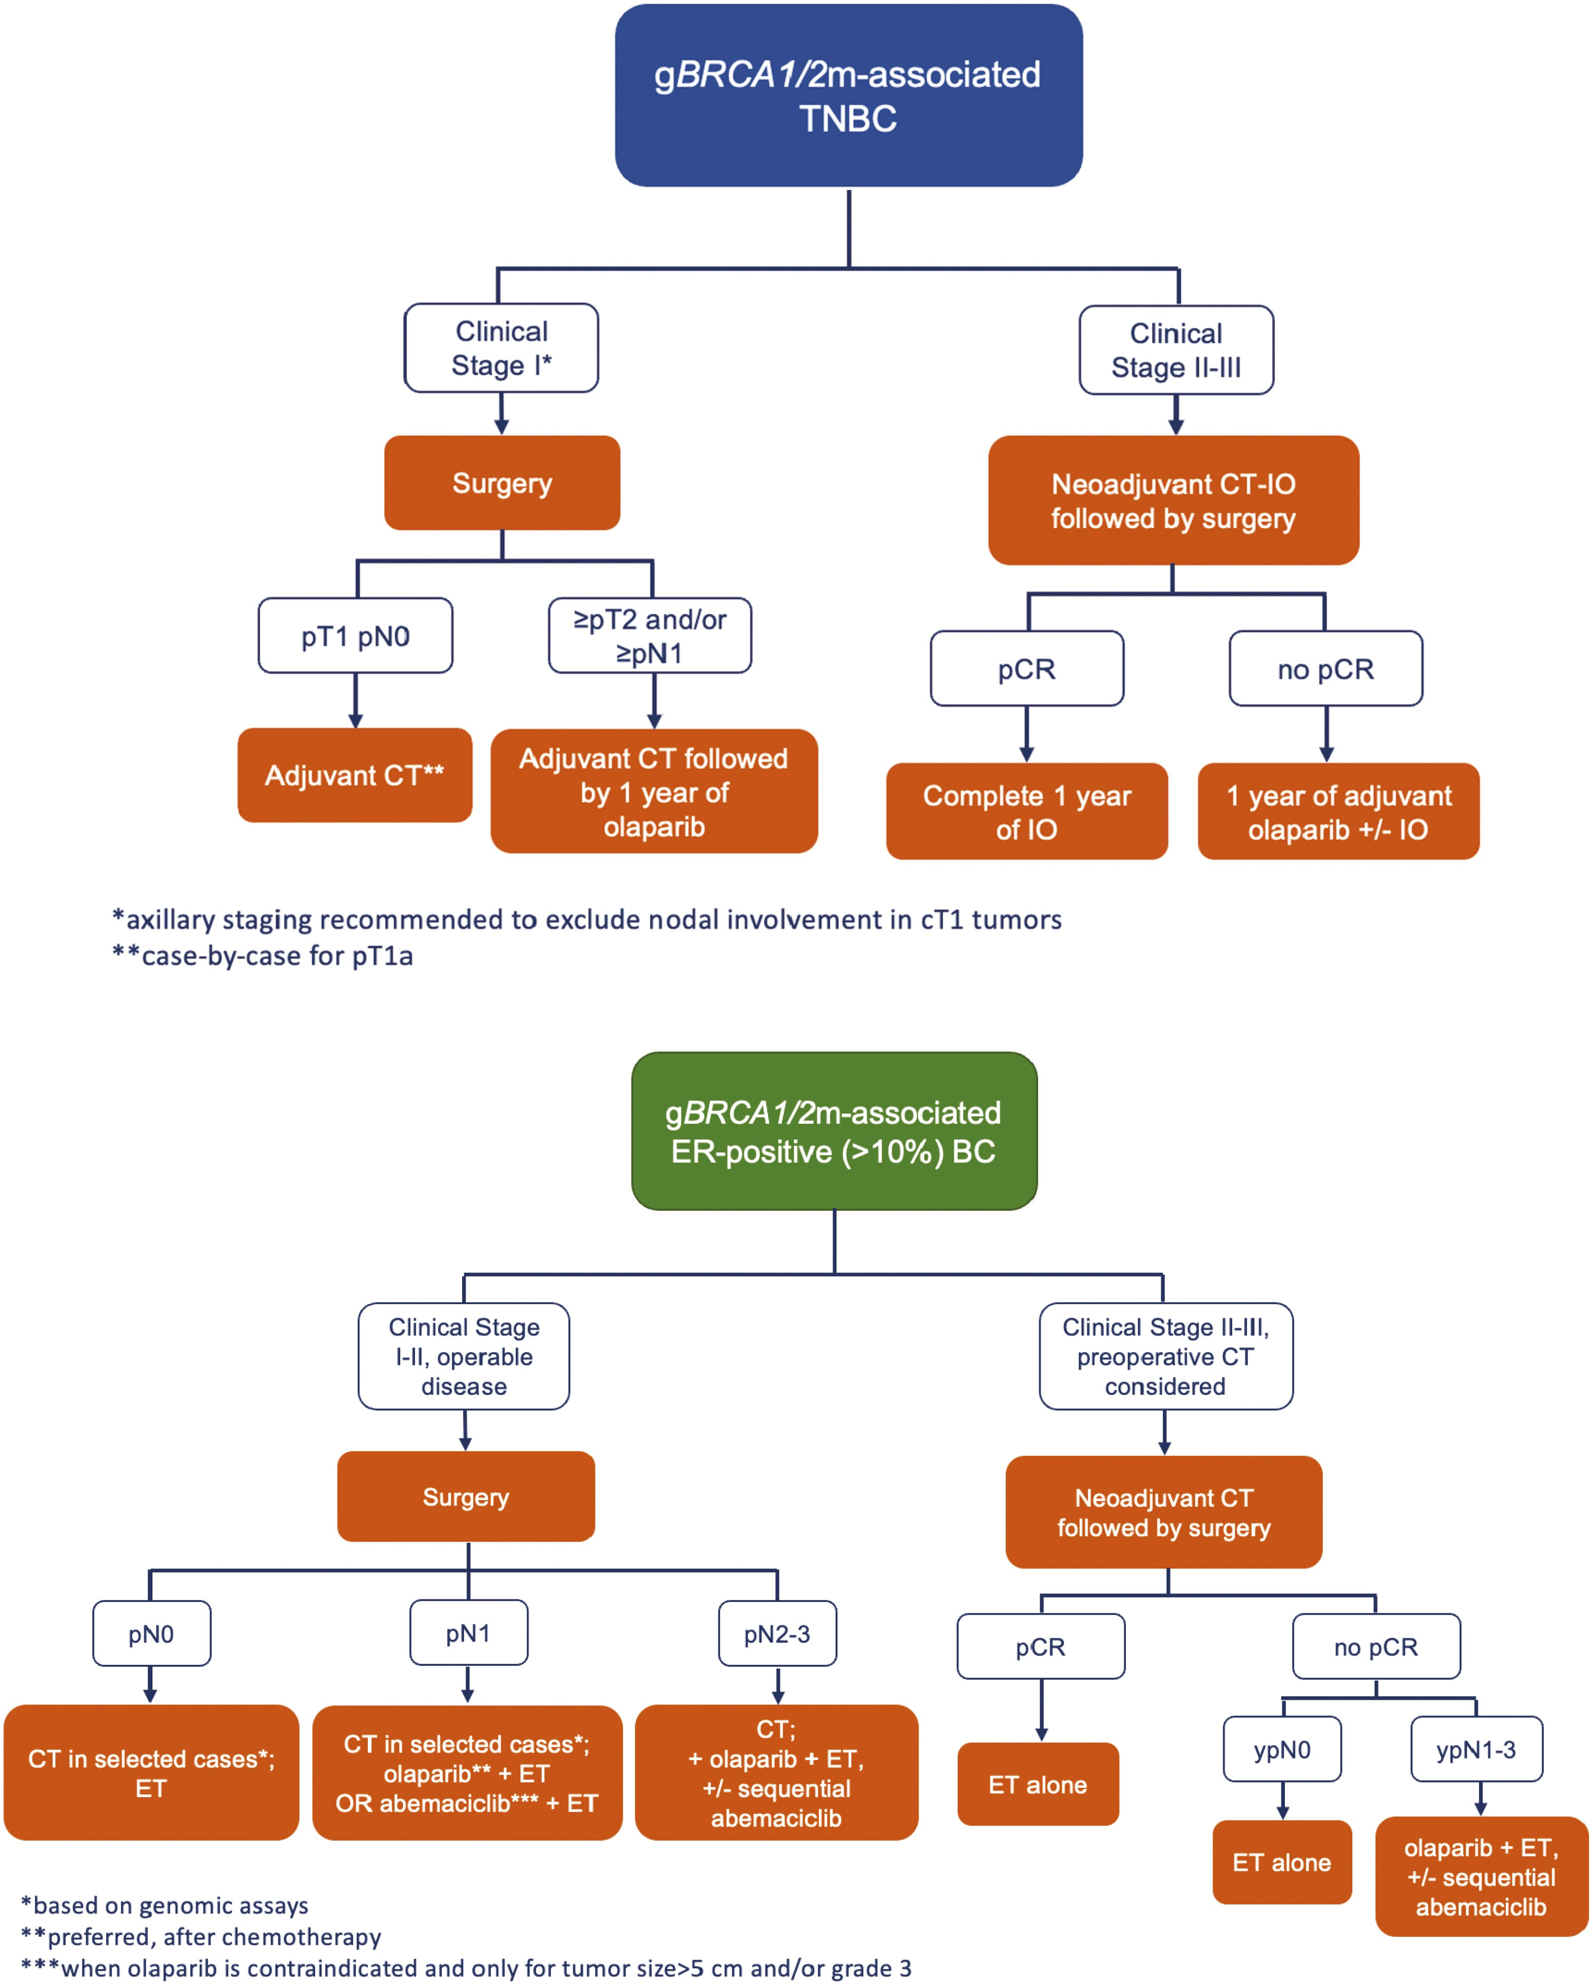
Management of HR+/HER2- EBC With gBRCA1/2m
Notes:
So, talking about hormone-positive, HER2-negative breast cancer with germline BRCA mutations how do you classify these patients and what do you do to treat them? I think there's definitely a difference between clinical stage 1 and 2, versus those who have stage 2 to 3 disease where you might be thinking about neoadjuvant. So, if you've got a higher stage disease over on the right, and you're thinking about neoadjuvant chemotherapy followed by surgery, then you're really dividing those patients after their neoadjuvant chemotherapy into whether they get to pCR or whether they don't.
So, if they get to pCR, they're going to get endocrine therapy alone afterwards. A lot of these patients don't get to pCR, of course, and we always counsel patients that pCR is less of a meaningful predictor in patients with ER-positive breast cancer But if they get there, then we give them endocrine therapy alone and– don’t consider olaparib. If they don't get to pCR, but their nodes are negative, then they also would receive endocrine therapy alone. If patients have node-positive disease after neoadjuvant, that's where we might consider endocrine therapy along with olaparib, and then after that year of olaparib is over, potentially considering sequential CDK 4/6 inhibitor therapy.
For patients who have stage 1 to 2 disease that is operable and go to surgery up front, certainly if they have node-negative disease, some patients might receive chemotherapy based on their Oncotype score or other genomic assay. They're all going to receive endocrine therapy, of course. If these patients have positive nodes at surgery, then they likely will get chemotherapy, especially if premenopausal, then you might also consider olaparib with endocrine therapy afterwards, or you could consider abemaciclib with endocrine therapy afterwards, depending on their disease characteristics and, of course, personal preferences.
And if they have lots of nodal disease, so N2 or N3, that's where we would really be thinking about chemotherapy for sure, and then olaparib endocrine therapy and probably pushing for sequential abemaciclib just to give patients the optimal chance of cure if they can handle all that therapy. It's a really nice way of laying it out.

Slide 27
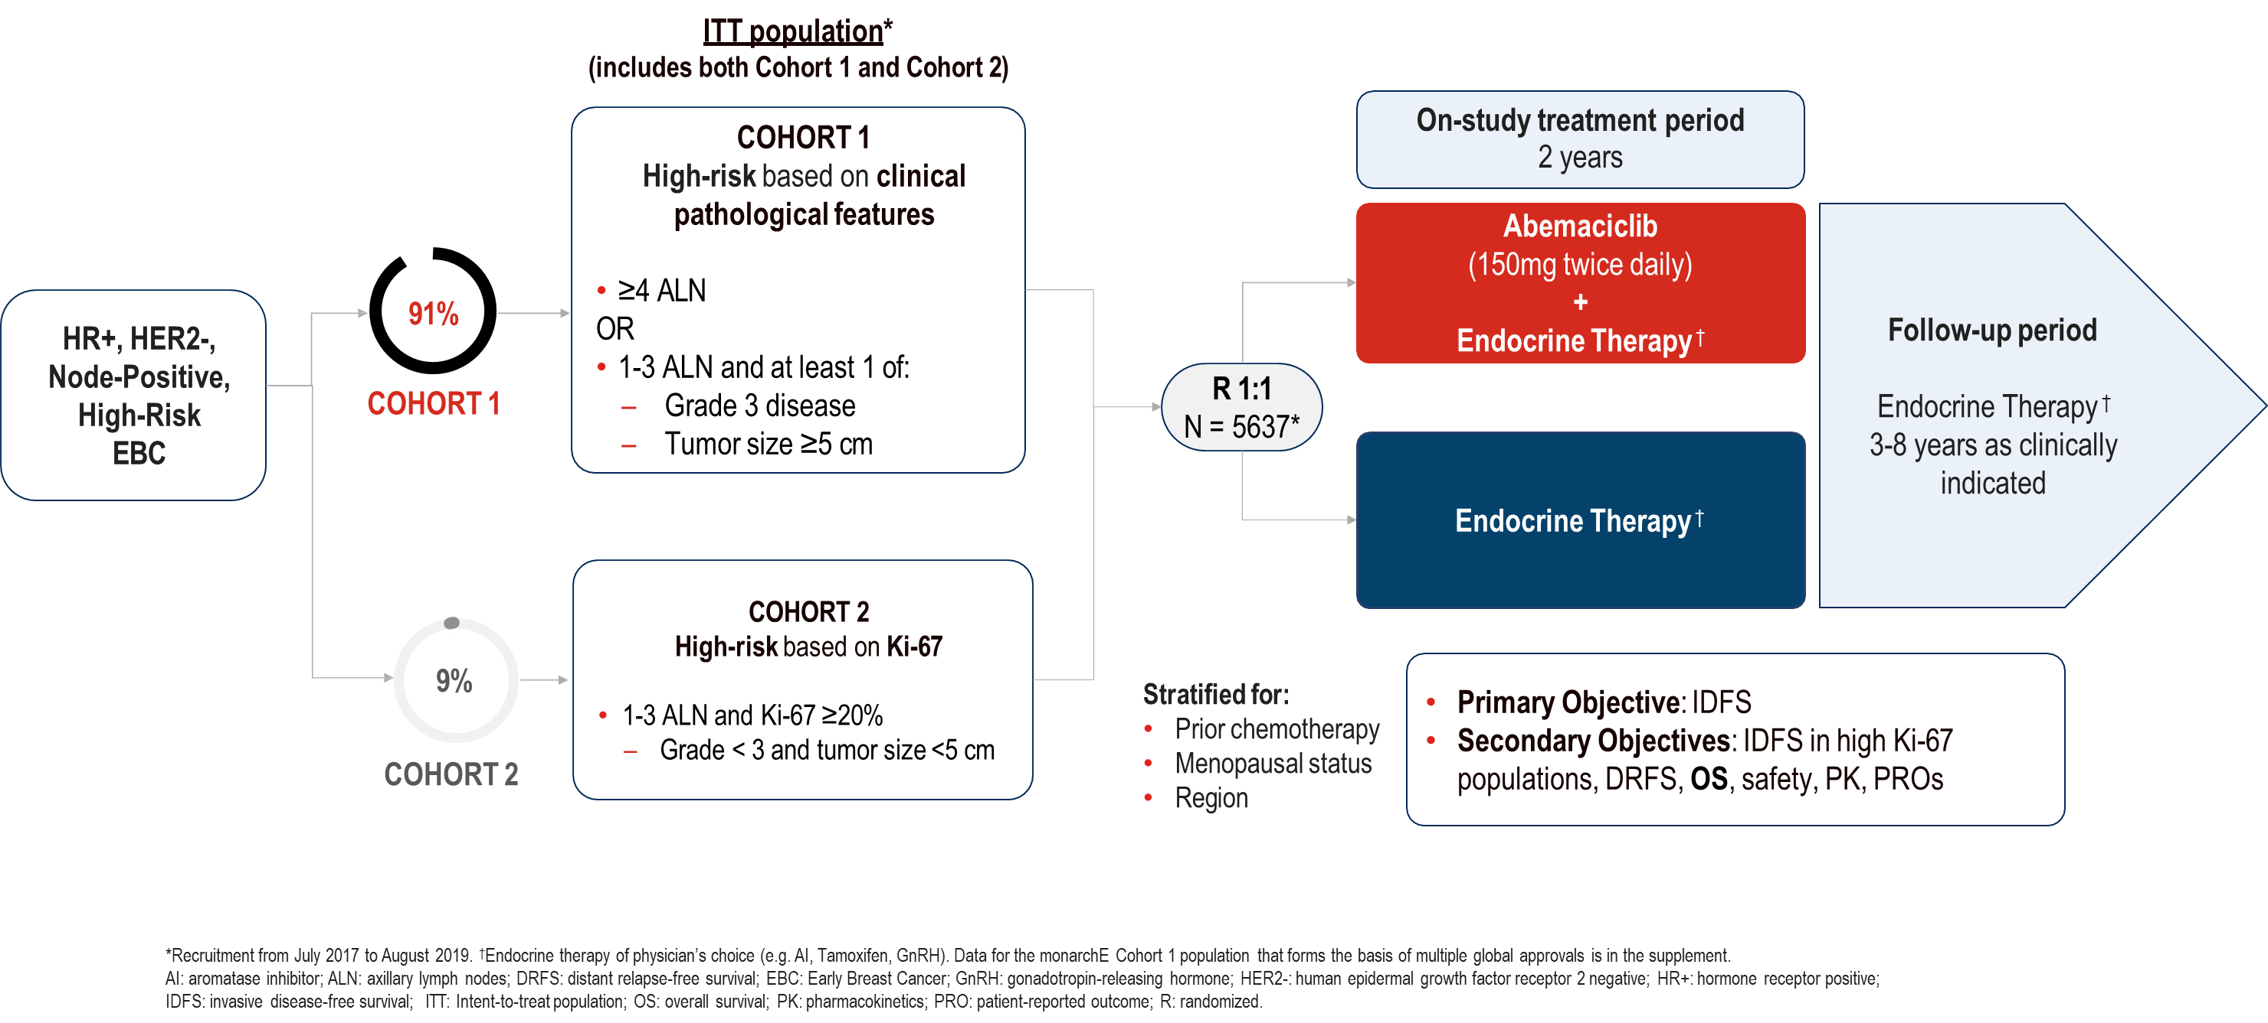
Phase 3 monarchE Trial of Adjuvant Abemaciclib + ET vs ET in HR+/HER2-, High-Risk EBC
Notes:
So, where do these CDK 4/6 inhibitor recommendations come from? So, the Phase 3 monarchE trial was a trial that looked at adjuvant abemaciclib and endocrine therapy versus endocrine therapy alone in patients with hormone-positive, HER2-negative, high-risk, early-stage breast cancer. So, now we're moving sort of away from the germline BRCA cohort explicitly to talk about patients with just high-risk, early-stage, ER-positive breast cancer.
So, these were patients with very high-risk disease. They either had to have had 4 or more positive lymph nodes, or could have had 1 to 3 positive nodes in at least either grade 3 disease, a tumor greater than 5 centimeters, or have a high Ki-67 index. So, this is a very high-risk group of node-positive patients.
They were enrolled after receiving appropriate chemotherapy, surgery, radiation, and then one-to-one were randomized to receive either endocrine therapy alone or endocrine therapy plus abemaciclib 150 milligrams twice daily. These patients were then followed. The abemaciclib was given for 2 years, so the study period where patients were actively on treatment was 2 years. And then, they were followed after that as clinically appropriate.
The primary objective was invasive disease-free survival, and then there were a number of different secondary objectives.

Slide 28
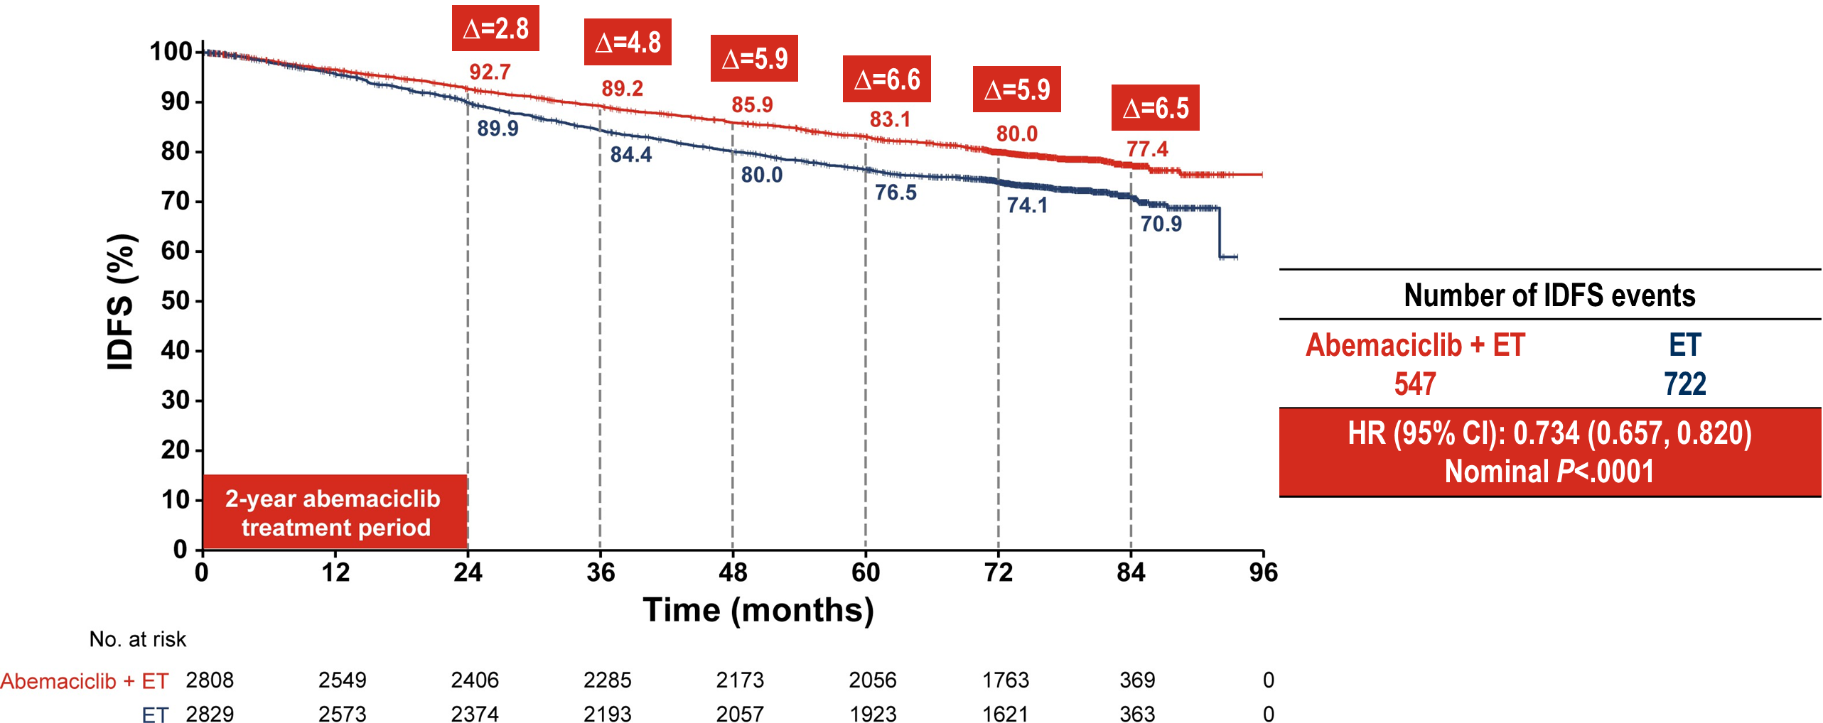
monarchE: IDFS (Primary Endpoint)
Notes:
And then, here are the results. 84-month primary endpoint of invasive disease-free survival. You can see that these curves started to separate really early on at 24 months, where you saw a 2.8% benefit in favor of the abemaciclib and that was really like right at the end of the treatment period. But then, as patients go on over time, you can see that those curves separate more and the overall benefit, the improvement in invasive disease-free survival, now looking at 84-months, is a 6.5% benefit, so 70.9% of patients in the placebo arm, the endocrine-only arm, were disease-free at an 84-month time point versus 77% of patients who received the abemaciclib for that 2-year time frame. So, really impressive data that's both statistically and clinically significant.

Slide 29
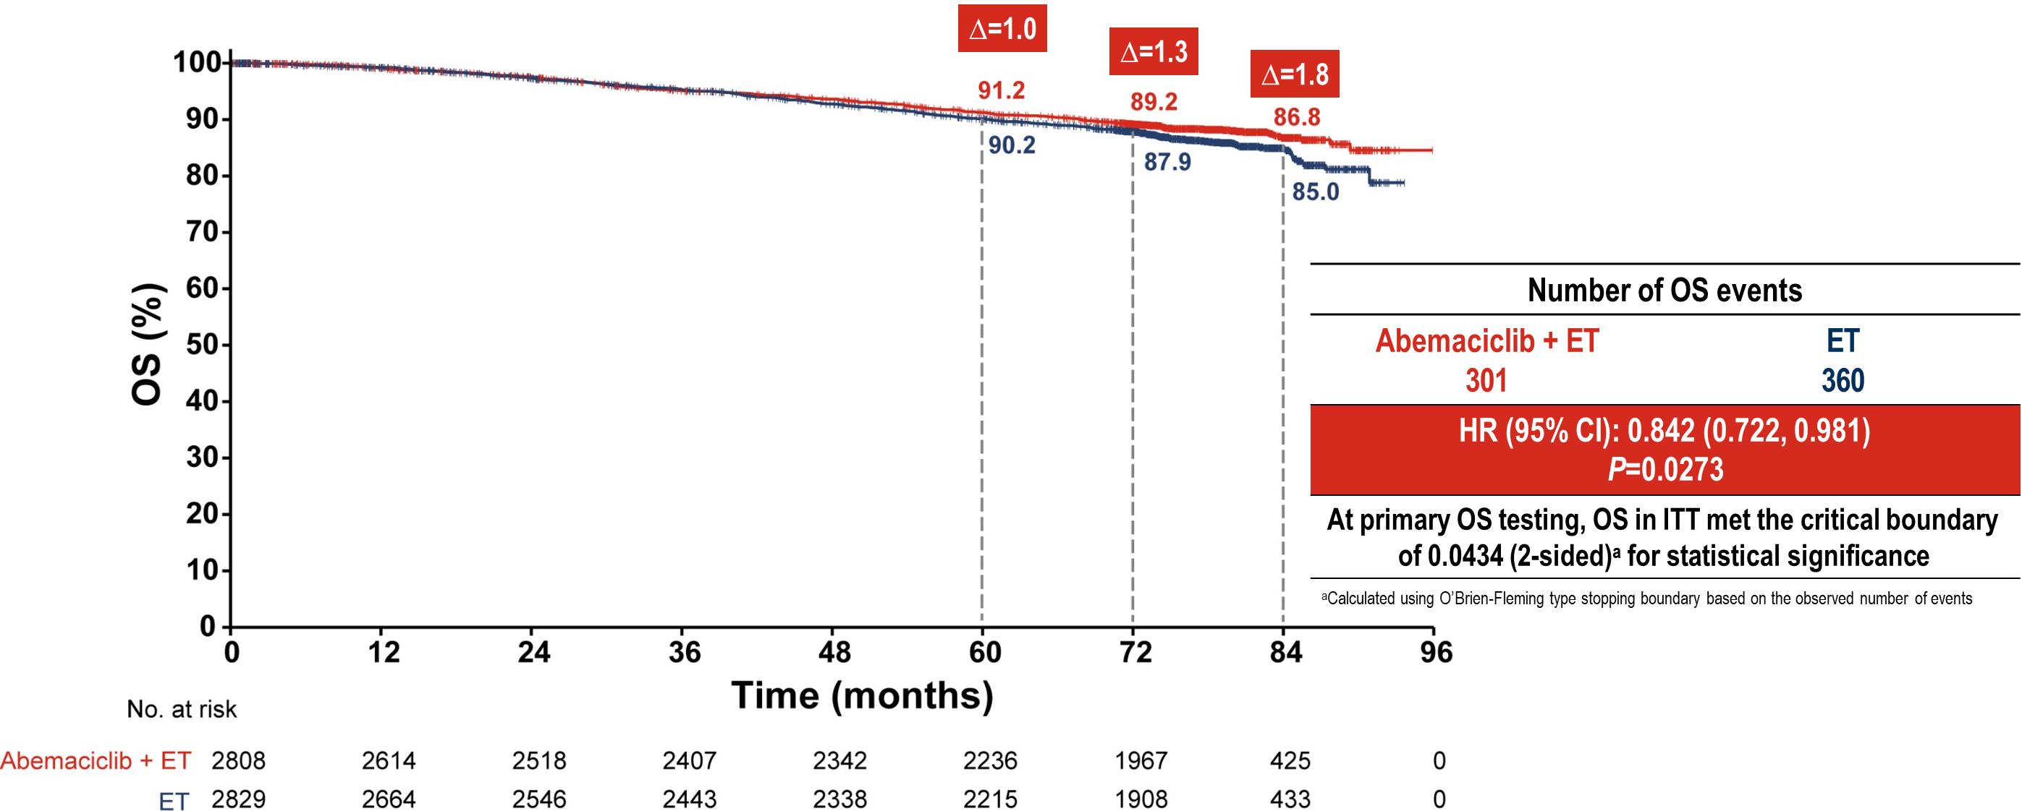
monarchE: OS
Notes:
And if you look at overall survival, this is an endpoint that is very hard to reach in trials of early-stage, ER-positive breast cancer, because not that many of these patients recur, thankfully, and when they do recur, they live for long periods of time. But you're starting to see, now that we're going out past 5 years, a slight separation of curves that will need to be continued to follow. So, definitely important to think about. And then, if you look at the statistical significance here, technically this was a statistically significant hazard ratio, not crossing 1, so technically, an overall survival benefit Clinically, it's a small number, 1.8% difference, but something that we do expect may continue to widen over time as we continue to follow patients.

Slide 30
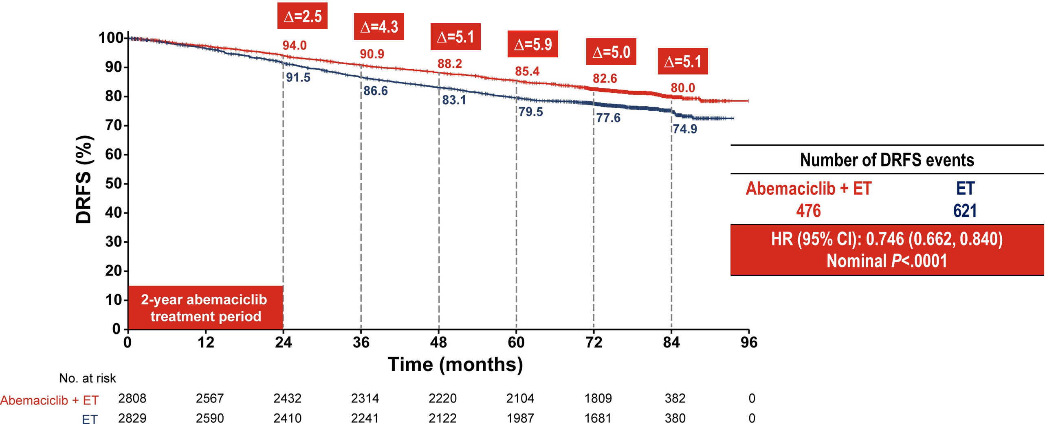
monarchE: DRFS
Notes:
This is looking at distant recurrence-free survival, that same trial, with those same endpoints. And you can see that distant recurrence-free survival has also improved at 84 months by 5.1% in patients who received abemaciclib for 2 years.

Slide 31
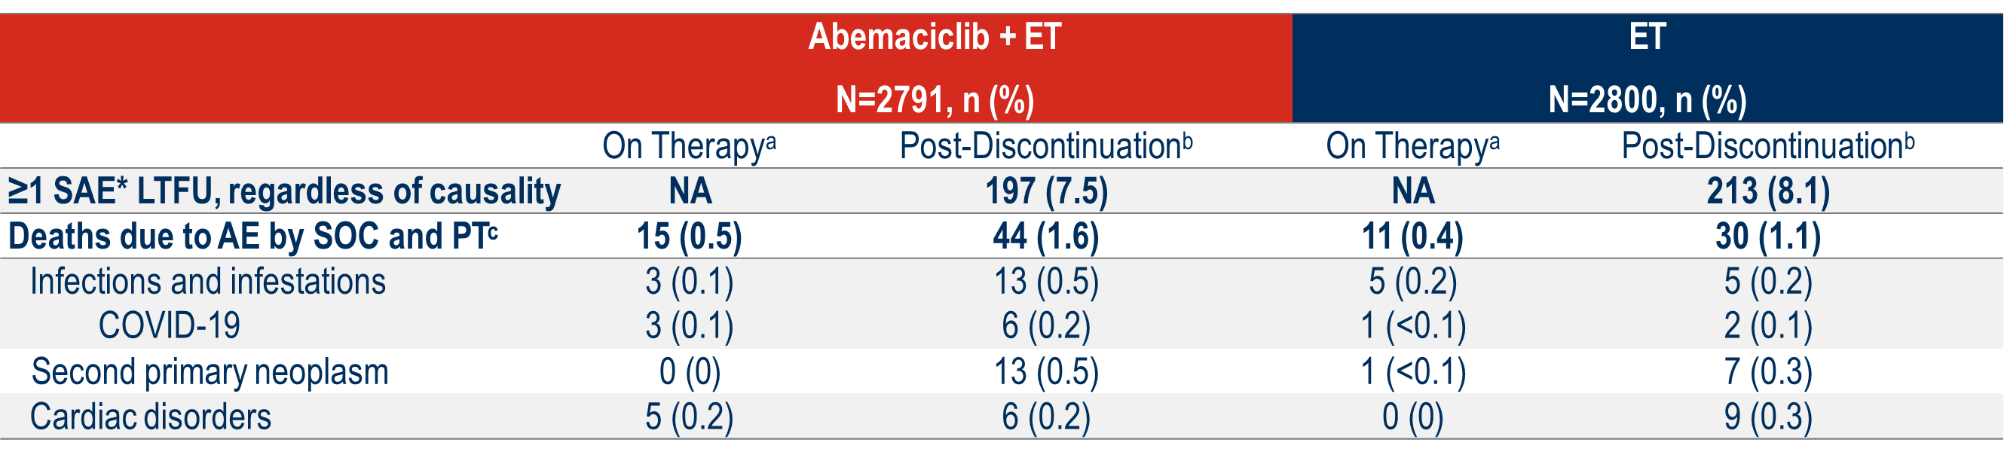
monarchE: SAEs and Fatal AEs
Consistent safety results from prior analyses, as all treated patients completed treatment ≥4 years ago
No relevant differences between treatment arms in causes of deaths due AEs
Notes:
And then, what about adverse events? Obviously something to think about. This is looking at patients on the abemaciclib arm on the left, the endocrine therapy alone on the right. And these were really consistent with the safety results from prior analyses of this drug. There were no relevant differences between treatment arms and causes of death due to adverse events. Certainly more diarrhea and cytopenias were seen in patients who received abemaciclib, but this was felt to be a cost that was worth it for most patients who were on the study.

Slide 32
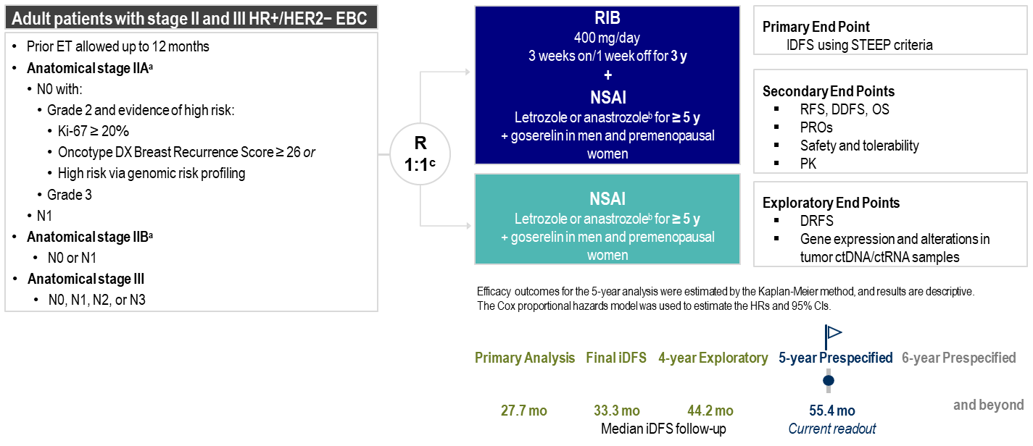
Phase 3 NATALEE Trial of Adjuvant Ribociclib + ET vs ET in HR+/HER2- EBC
Notes:
And then, what about NATALEE? So, NATALEE is another Phase 3 trial of adjuvant CDK 4/6 inhibitors. This was a trial that looked at ribociclib plus endocrine therapy as opposed to abemaciclib. The main differences in this study, other than the different CDK 4/6 inhibitor, was that this trial looked at 3 years of the CDK 4/6 inhibitor intervention as opposed to 2 years. It also allowed a slightly less high-risk patient population.
These patients had either stage 2 or stage 3 disease, but could be T2 and 0. If they were T2 and 0, they had to have either high-risk Oncotype score, a higher Ki-67 index, or be a grade 3. So, these patients had to have some high-risk criteria, but could be node-negative, as opposed to the abemaciclib study where they were all node-positive. The other thing to note is that this study allowed patients to have already started their endocrine therapy up to one year ago, whereas in the trial of abemaciclib, they only were allowed to have had 3 months on their endocrine therapy before going on the study.
This is a more stringent criteria in the previous study, but this study also was a positive study, which I'll show you. They looked at a 3-year intervention, also a one-to-one randomization.

Slide 33
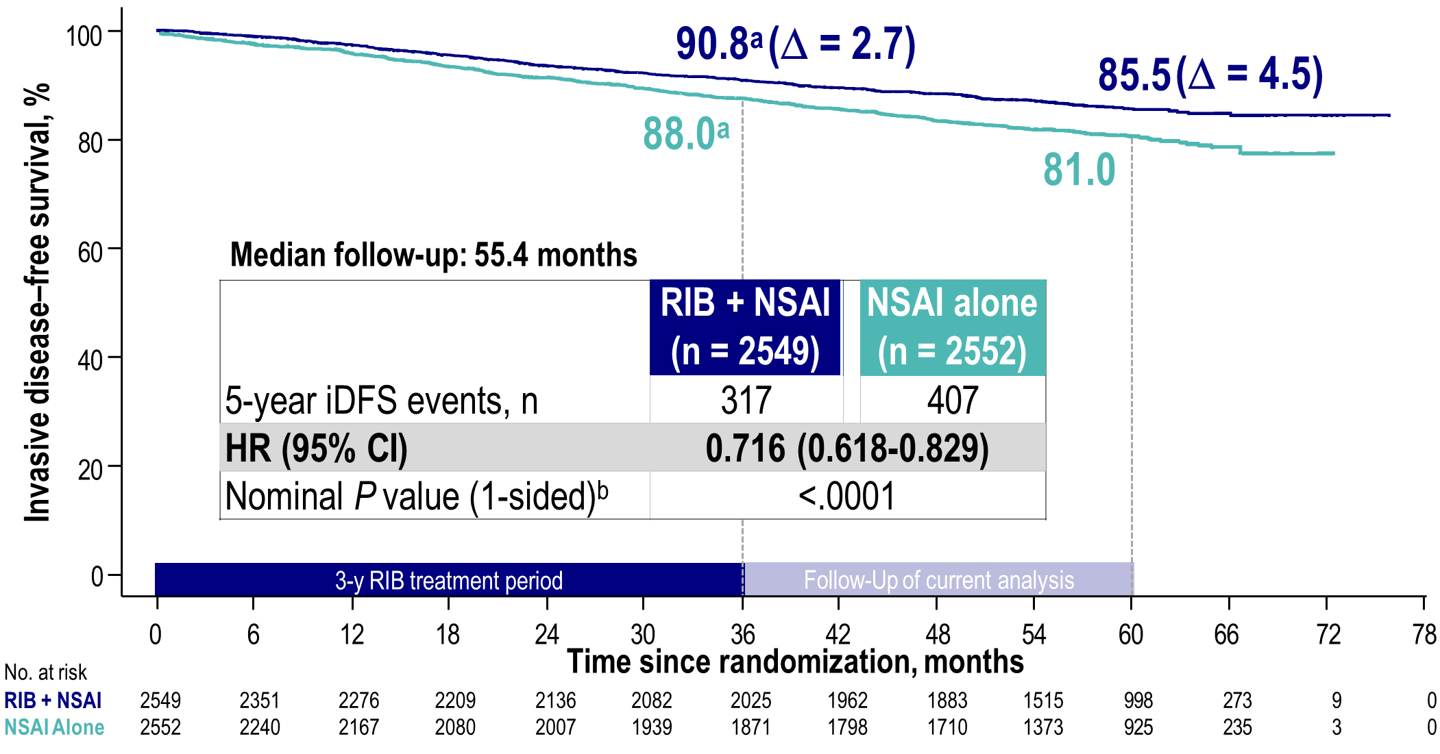
NATALEE: IDFS
Notes:
And then, the invasive disease-free survival data that we have so far, looking out at the 5-year mark, 60 months, is a 4.5% difference in favor of the ribociclib arm. So, 81% of patients disease-free at 5 years. And the patients who received placebo or no ribociclib, as it was. But 85% of the patients who were on ribociclib are disease-free at that time point. So, both clinically and statistically significant.

Slide 34
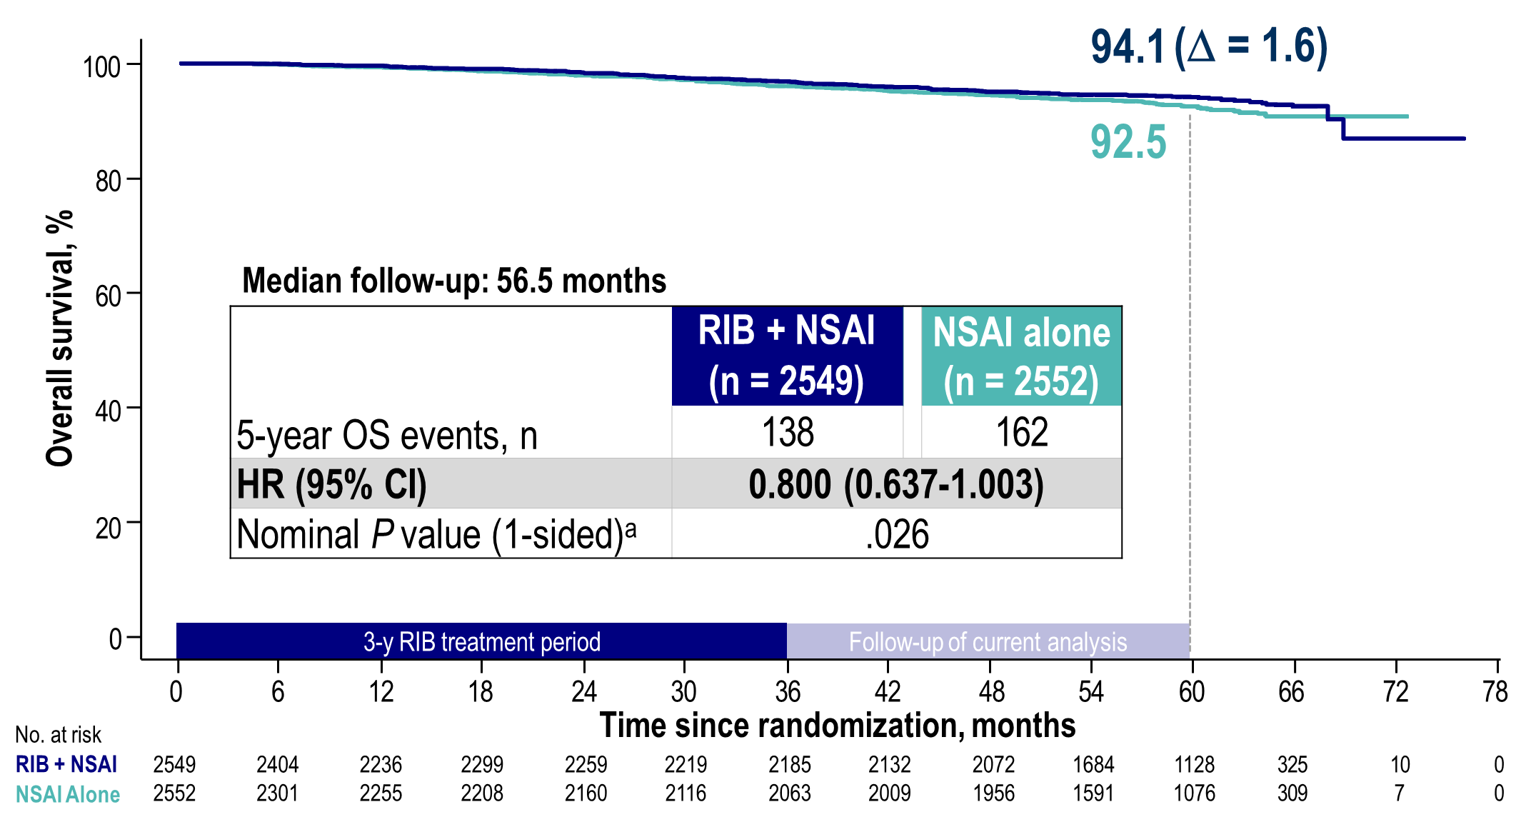
NATALEE: OS
Notes:
Overall survival, this hazard ratio, as you can see, does technically cross 1, but it is very possible that as we follow these patients further out beyond 5 years, we may too start to see a small overall survival benefit in this patient population.

Slide 35
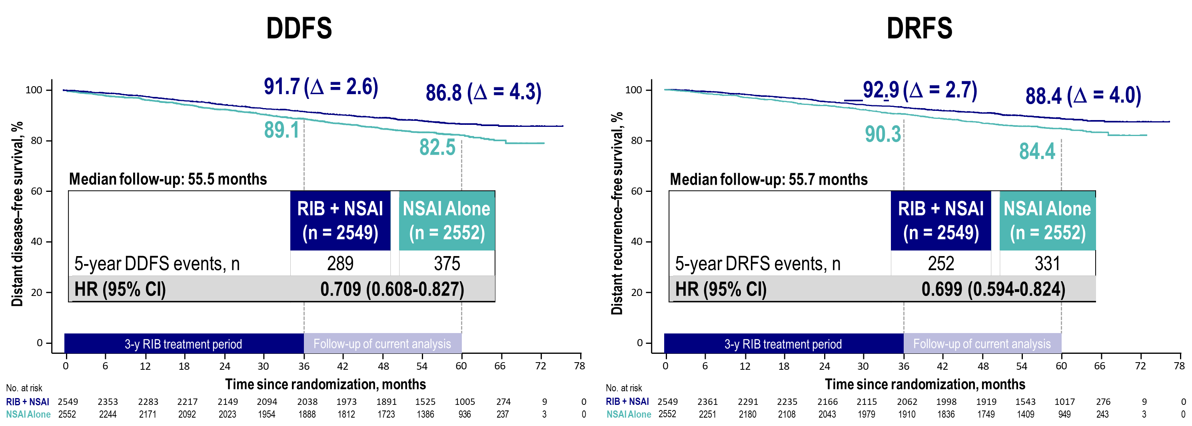
NATALEE: DDFS and DRFS
Notes:
This slide here, is looking at distant disease-free survival and also distant recurrence-free survival, and you can see that these endpoints also were positive in favor of continuing the ribociclib.

Slide 36
NATALEE: Deaths and Key Safety Assessments
5 deaths due to AEs occurred; these deaths were not considered related to study treatment
  3 patients in the ribociclib + NSAI arm (brain hemorrhage, myocardial infarction, gastric adenocarcinoma)
  2 patients in the NSAI alone arm (rectal adenocarcinoma, aortic aneurysm rupture)
The proportion of patients who developed secondary primary malignancies was similar in the 2 arms (ribociclib + NSAI: 67 patients [2.7%]; NSAI alone: 74 patients [3.0%])
Notes:
What about deaths and safety assessments? There were 5 deaths due to adverse events, but these were not considered related to study treatment. You can see the list here of what happened in each of these individual patients. The proportion of patients who developed second primary malignancies was also similar in both arms. So, no new safety assessments. This is a drug that we've all been using in the metastatic setting for quite some time. It performed very similarly in terms of how patients tolerated it in the upfront setting.

Slide 37
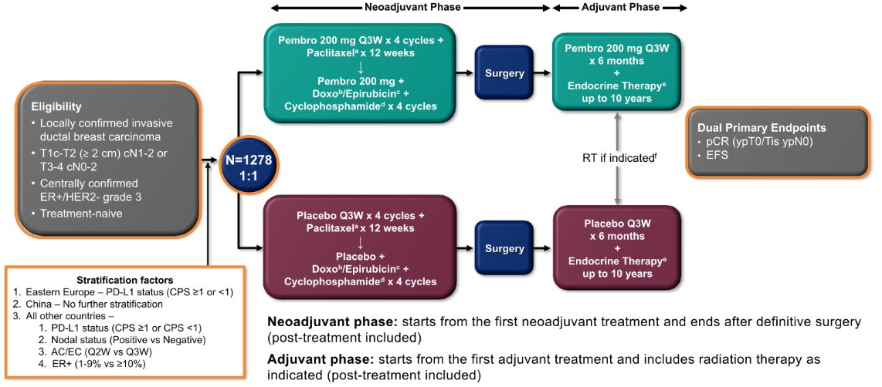
Phase 3 KEYNOTE-756 Trial of Perioperative Pembrolizumab in HR+/HER2- EBC
Notes:
So, what about pembrolizumab for patients with ER-positive early-stage breast cancer? We know that from KEYNOTE-522 that pembrolizumab, works very, very well in patients with triple-negative breast cancer and that has become a standard of care of what we give to our early-stage patients. And we give it along with 24 weeks of chemotherapy, neoadjuvantly, followed by an adjuvant course.
And then, what about these hormone-positive patients with high-risk disease? So, KEYNOTE-756 looked at patients who had either T1C or T2 disease that was also node-positive, or T3 to 4 disease that had any nodal status. These patients had to have had grade 3 ER-positive breast cancer, and be treatment naive. They were then randomized one-to-one prior to surgery to receive either a very similar regimen to what was received in the KEYNOTE-522 trial, which was chemotherapy along with paclitaxel and then also, epirubicin or doxorubicin plus cyclophosphamide, with either placebo every 3 weeks or with pembrolizumab. Patients all then went to surgery and then, similarly to the KEYNOTE-522 trial received pembrolizumab afterwards for 6 months plus endocrine therapy or placebo plus endocrine therapy. pCR and event-free survival were dual primary endpoints of this study.

Slide 38
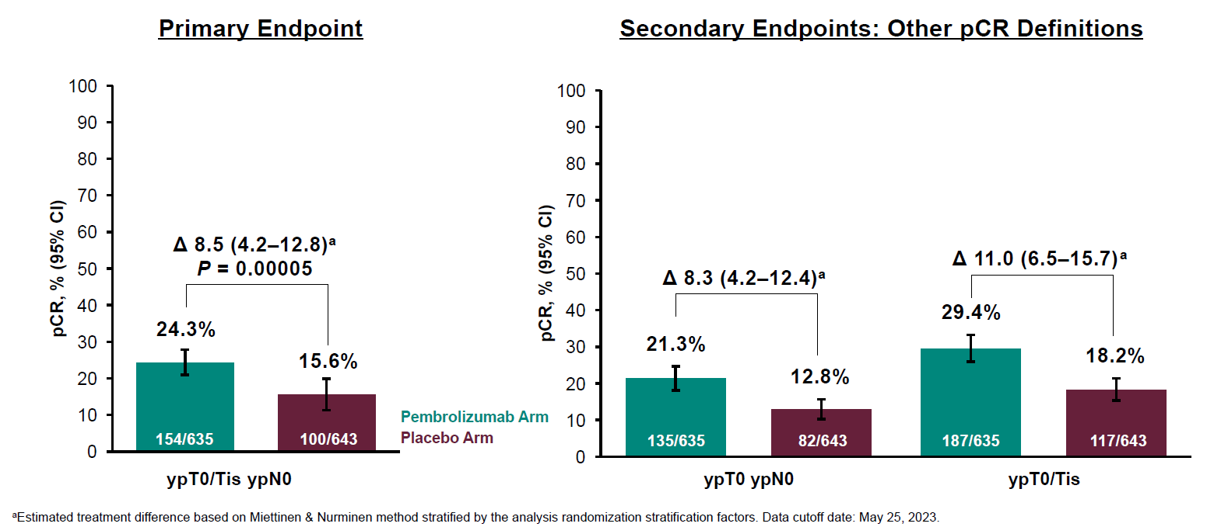
KEYNOTE-756: pCR at the First Interim Analysis
Notes:
You can see here, the primary endpoint, looking at pCR rates, higher certainly, in the patients who received the pembrolizumab, 8.5% difference with 24.3% of patients who received the pembrolizumab getting to pCR versus just 15.6% in the placebo arm. And then these other pCR definitions, you can see that there are different ways to define pCR. Do you include DCIS or do you not? But you can see that all of these clearly did favor the pembrolizumab in this patient population.

Slide 39
KEYNOTE-756: Immune-Mediated Adverse Events During the Neoadjuvant Phase
Immune-Mediated AEs, % | Pembrolizumab (n = 634) | Placebo (n = 642)
Any grade | 32.8 | 7.0
Grade 3/4 | 7.1 | 1.2
Hypothyroidism | 17.5 | 1.7
Hyperthyroidism | 9.0 | 0.5
Pneumonitis | 2.8 | 1.4
Adrenal insufficiency | 2.5 | 0
Severe skin reaction | 2.2 | 0.5
Hypophysitis | 1.9 | 0.2
Thyroiditis | 1.7 | 0.3
Hepatitis | 1.3 | 0.5
Colitis | 0.9 | 0.8
Vasculitis | 0.8 | 0.6
Notes:
In terms of immune-related adverse events, we obviously saw more of these in the pembrolizumab arm than in the placebo arm, with most of these being hypothyroidism and thankfully most of these being low-grade. And I think the challenge of the pCR is that that's not always the best predictor of prognosis in these patients with ER-positive disease, although maybe a better predictor of prognosis in patients who are exclusively grade 3, as this population was, so it does beg the question of should we be using this? It is not standard of care in this patient population, but definitely is something that I think we need to follow closely.

Slide 40
Management of Early-Stage TNBC With gBRCA1/2m
Notes:
So, for patients with germline BRCA-mutated, triple-negative breast cancer, how are we thinking about this patient population? This is a little bit easier, I think, than thinking about the patients with ER-positive disease because there's so many moving parts in terms of how we interpret pCR and then what we do with regards to CDK 4/6 inhibitors. But here's how we look at those TNBC patients.
So, for most clinical stage 1 patients, they're going to go straight to surgery. If they are truly node-negative at the time of surgery, and truly stage 1, then they'll receive adjuvant chemotherapy. If they have more than stage 1 disease, if they are either node-positive or turn out to have more than 2 centimeters of disease, they can get chemotherapy and also receive a year of adjuvant olaparib.
I think it's rarer that we come up with these patients just because so many triple-negative breast cancer patients are getting neoadjuvant chemotherapy these days. But if that does happen, that your patient goes to surgery and you find out, oh, hey, they're germline BRCA mutated and they also have a tumor that's greater than 2 centimeters or node-positive but we didn't realize, they are actually olaparib candidates. So, I think that is an important pearl to remember.
And then, the more common scenario, if patients have a stage 2 or 3 disease and they're receiving neoadjuvant chemotherapy with immunotherapy, then we're really dividing them after that into pCR versus non-PCR. If they get to pCR, then they're completing 1 year of adjuvant immunotherapy or enrolling in a trial, like optimized pCR, that potentially allows them to omit that immunotherapy. If they don't get to pCR, then, assuming they don't have a clinical trial to enroll in, they would be receiving a year of adjuvant olaparib plus or minus immunotherapy.
So, important just to know where that olaparib comes in.

Slide 41
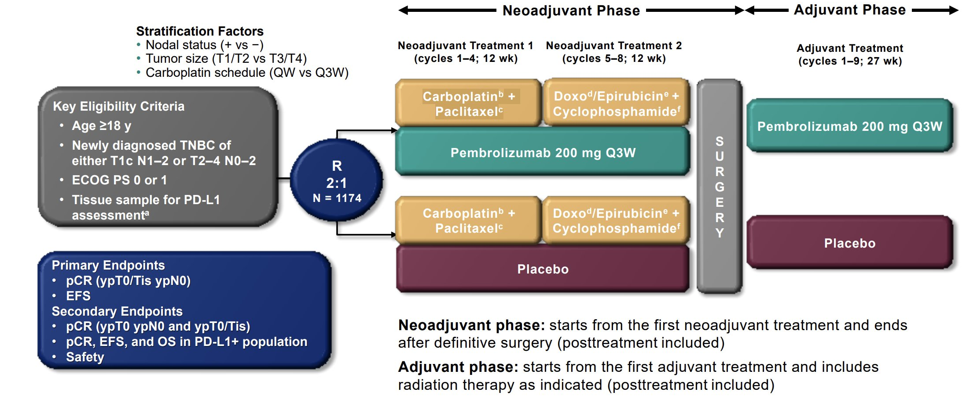
Phase 3 KEYNOTE-522 Trial of Perioperative Pembrolizumab in Early-Stage TNBC
Notes:
So, the 522 trial I've mentioned already. This was the pivotal trial that led to the incorporation of chemo along with immunotherapy in patients with earlier stage triple-negative breast cancer. This was not just germline BRCA mutation carriers, but all triple negative breast cancer patients with stage 2 or 3 disease.
Patients were randomized in this study in a 2-to-1 fashion to receive either 12 weeks of platinum with paclitaxel, followed by anthracycline plus cyclophosphamide, and then patients either received placebo along with that 24-week course or pembrolizumab every 3 weeks along with that 24-week course.
Patients then went to surgery and the patients who received pembrolizumab pre-op also received pembrolizumab post-op. The patients who did not receive pembrolizumab received placebo afterwards.

Slide 42
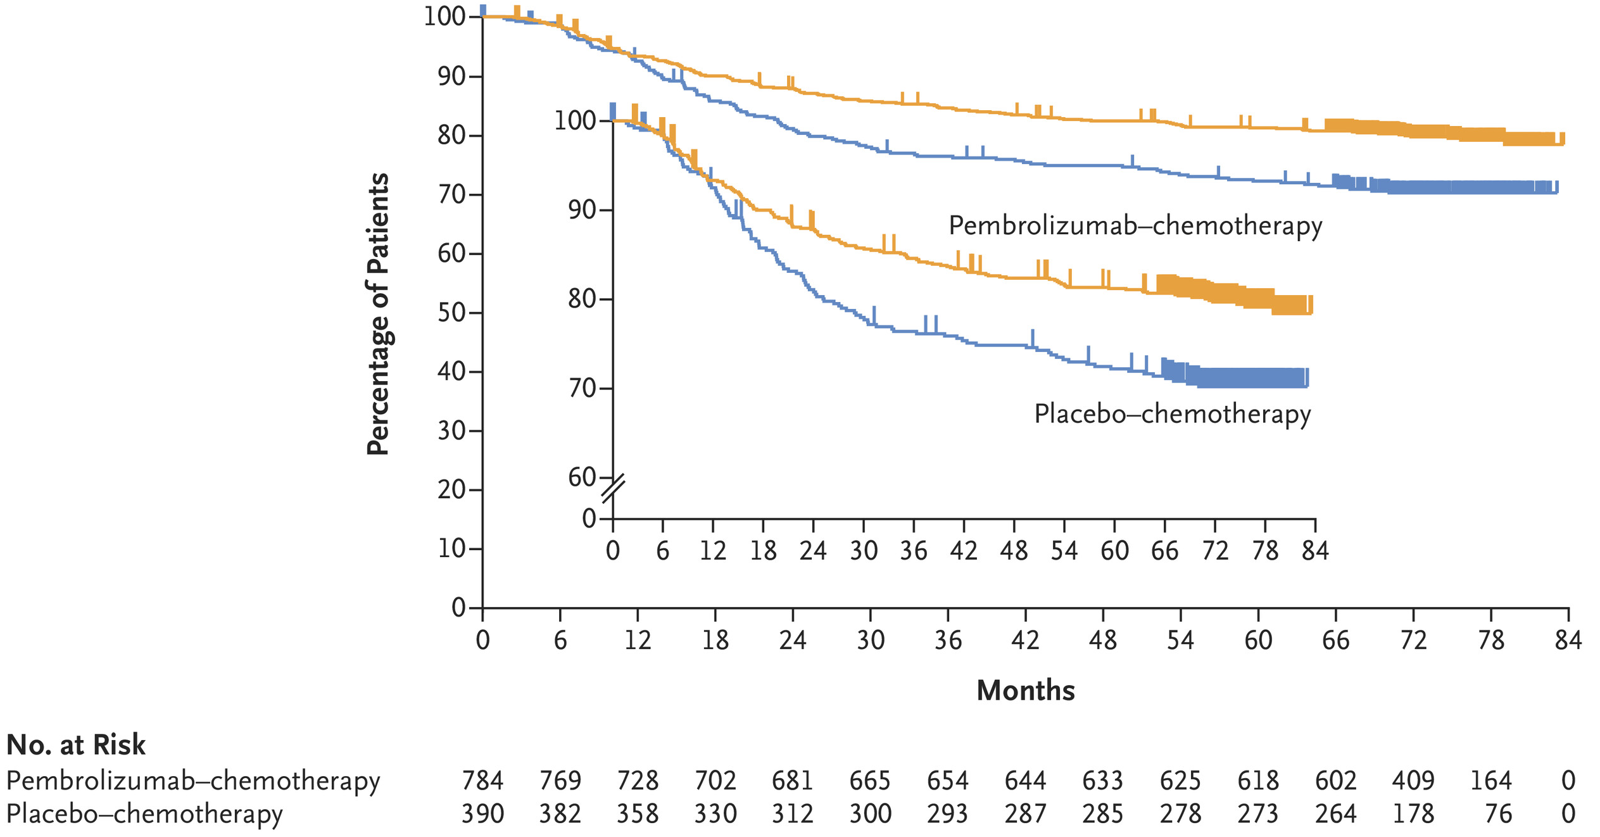
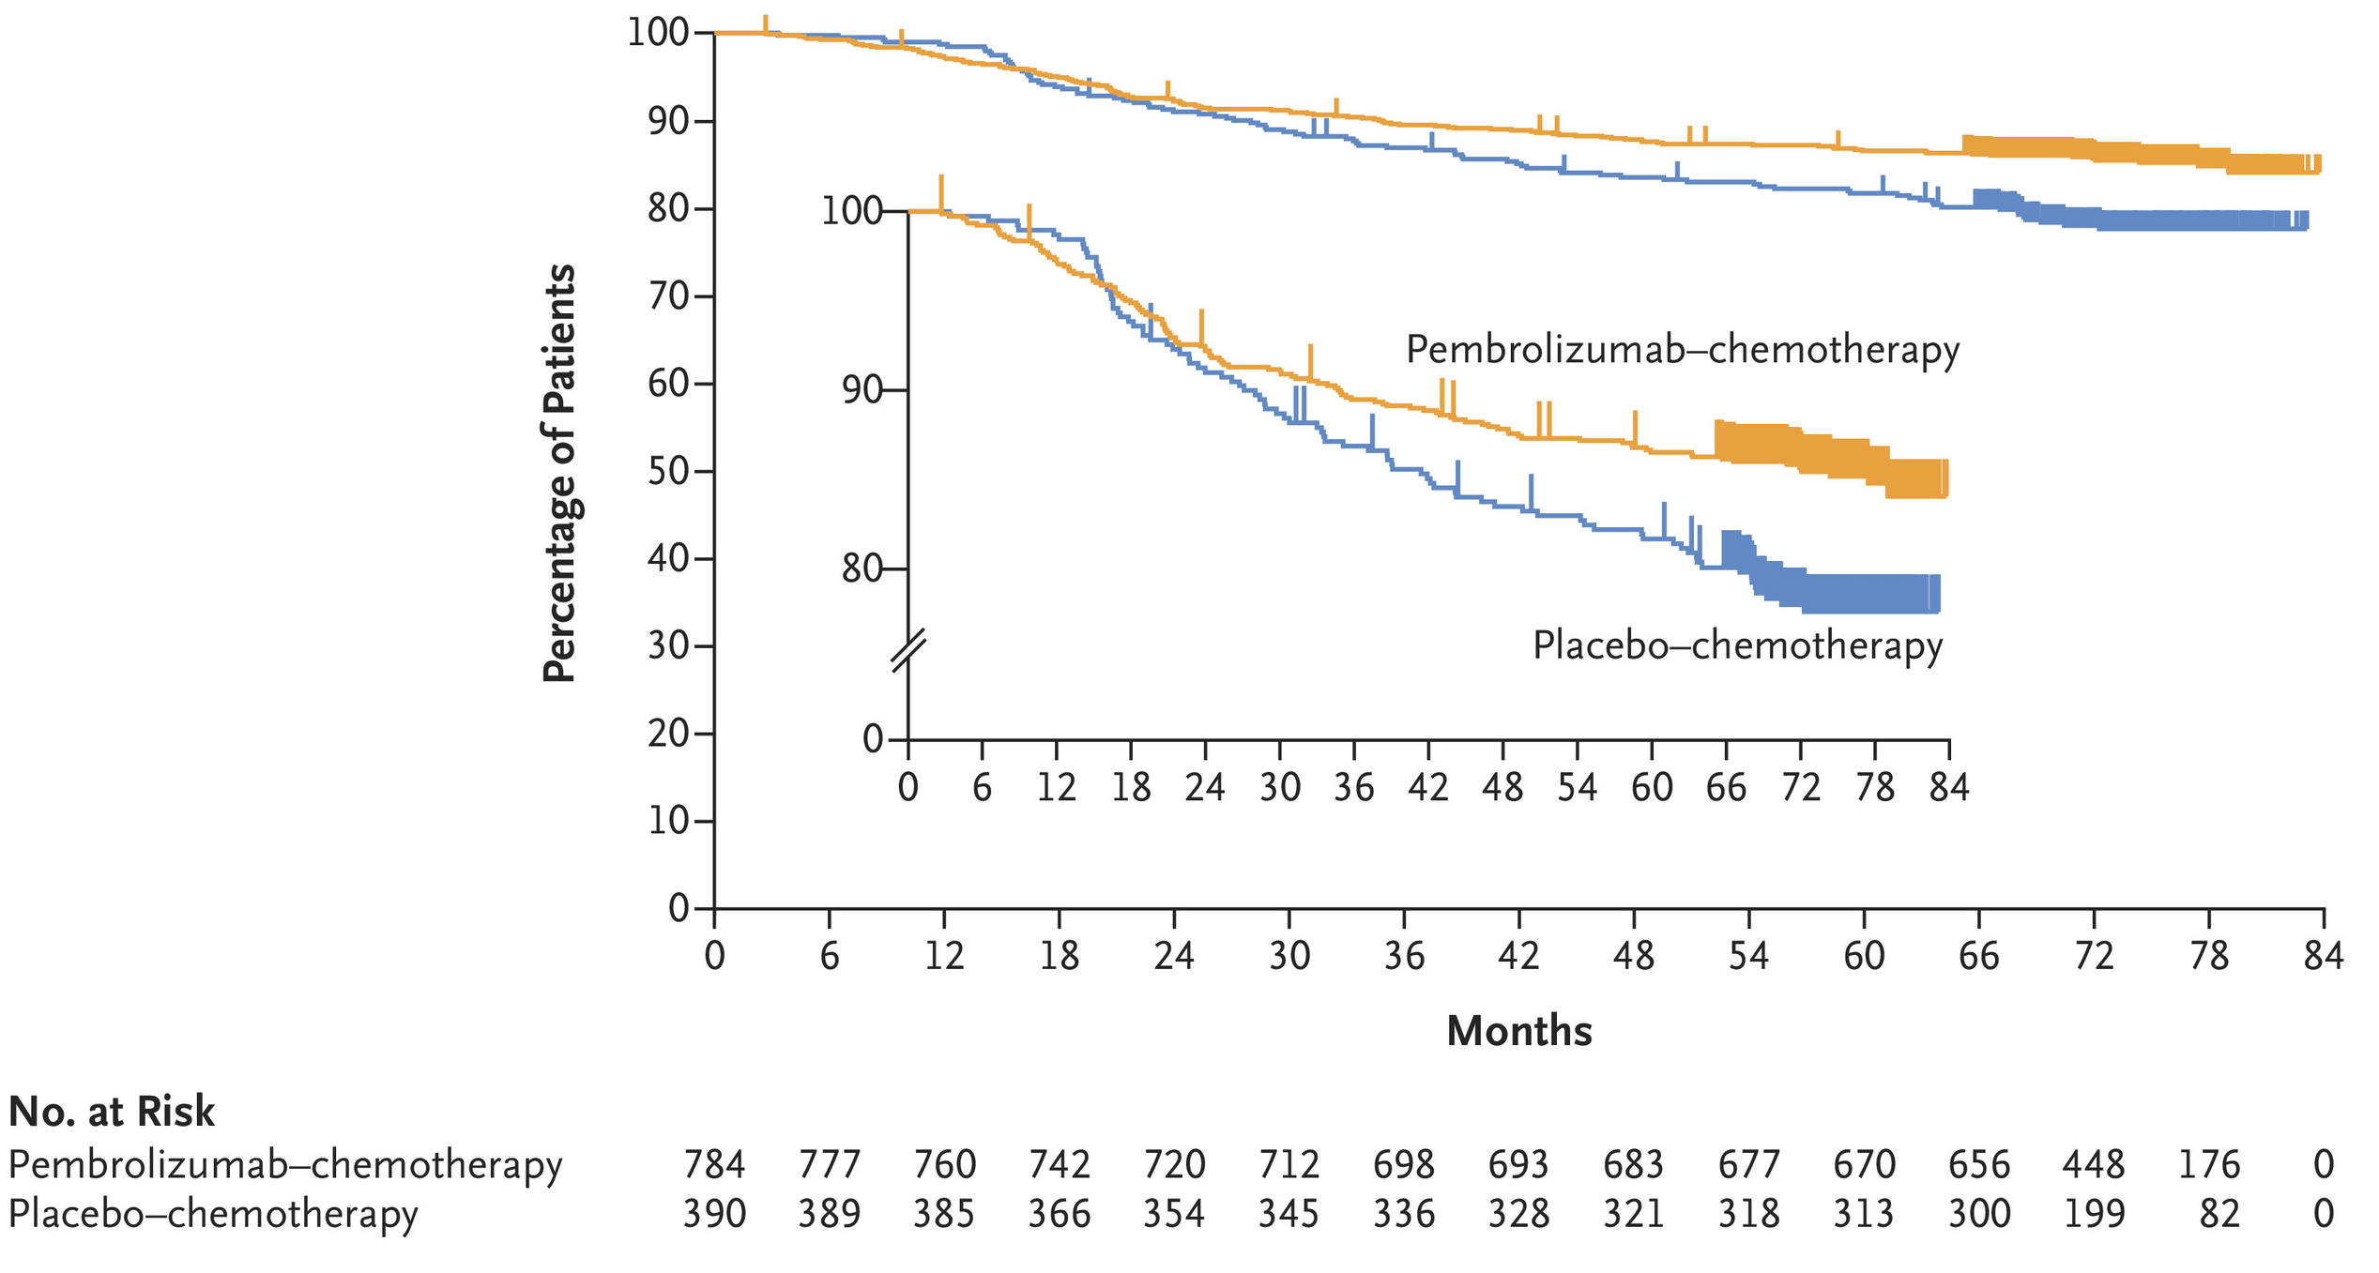
KEYNOTE-522: EFS and OS
EFS
OS
5-year EFS: 81.2% vs 72.2%
5-year OS: 86.6% vs 81.7%
Notes:
So, a complex trial with a lot of therapy. But what we found is that the addition of the pembrolizumab improved event-free survival and overall survival in this patient population. So, if you'll get 5-year event-free survival data, you can see there's almost a 10% improvement for the patients who received pembrolizumab. And then 5-year overall survival data is also bearing that out because unlike with ER-positive breast cancer, these patients do tend to succumb to their disease earlier, so you see those overall survival curves separating more quickly and also more meaningfully.

Slide 43
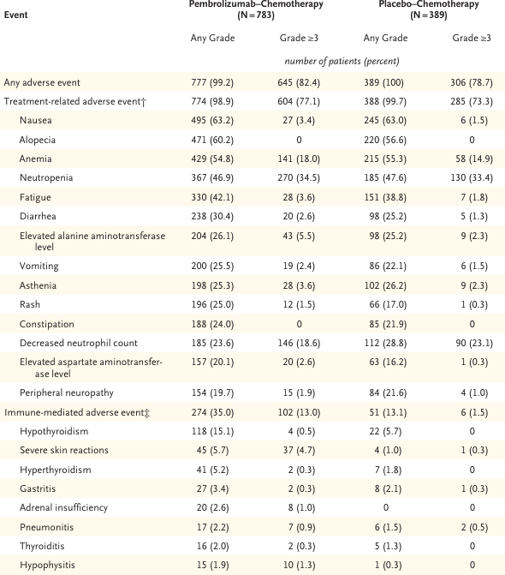
KEYNOTE-522: Adverse Events
Adverse Events, % | Neoadjuvant and Adjuvant Phases
 | Pembro + CT/Pembro (n = 783) | Placebo + CT/Placebo (n = 389)
Treatment-related AEs Any grade Grade 3-5 Serious Led to death Led to discontinuation | 98.9 77.1 34.1 0.5* 27.7 | 99.7 73.3 20.1 0.3† 14.1
Immune-mediated AEs/IRs Any grade Grade 3-5 Serious Led to death Led to discontinuation | 43.6 14.9 10.6 0.3‡ 10.9 | 21.9 2.1 1.3 0 2.6
Notes:
Looking at adverse events, most of the adverse events that were more significant in the pembro arm were the immune-related adverse events, so mostly things like hypothyroidism, some skin reactions, dermatologic issues, occasionally gastritis. We didn't see a whole lot of other major adverse events. There was a little bit of adrenal insufficiency but most of these patients had grade 1 or 2 adrenal insufficiency, and it was only 2.6% of the population. And the rest of the side effects that patients experience were really more related to the chemotherapy. So, nausea seen in about 60% in both groups, alopecia in about 60% in both groups, and then of course, the cytopenias and fatigue that you would expect with chemotherapy.

Slide 44

Phase 2 OlympiaN Trial of Neoadjuvant Olaparib ± Durvalumab in HER2- EBC With BRCA1/2 Mutation
Key eligibility criteria
Cohort A (lower risk)
T1b (>5 mm but ≤10 mm), N0 or
T1c (>10 mm but ≤20 mm), N0
Post-treatment follow-up per local practice
Primary
endpoint
Adults with histologically confirmed, newly diagnosed, primary, operable, non-metastatic invasive breast cancer
cT1b, N0
cT1c, N0
cT1, N1
cT2, N0
Known BRCAm
ER negative or low (≤10%)
Any PgR status
HER2-negative
ECOG PS 0 or 1
Would otherwise receive
neoadjuvant chemotherapy
No evidence of distant metastases
Olaparib 300 mg BID continuously
4–6 x 28-day cycles
n=25
Definitive
surgery
For patients with pCR:
Adjuvant olaparib could be offered in place of standard of care for
6–8^{b} x 28-day cycles, at the investigator’s discretion
pCRª
Cohort B (higher risk)
T1 (>1 mm but ≤20 mm), N1 or
T2 (>20 mm but ≤50 mm), N0
Study endpoints
Olaparib 300 mg BID continuously
+ durvalumab 1500 mg IV Q4W
4–6 x 28-day cycles
n=25
1º
pCR rate by ICPR, defined as ypT0/Tis ypN0
2º
pCR rate by local pathology review
Residual cancer burden by ICPR/local pathology review
Tumor volume by MRI
Safety and tolerability
Notes:
This trial is looking at the OlympiaN trial, so not OlympiA, but OlympiaN. This is looking at neoadjuvant olaparib plus or minus durvalumab in HER2-negative early breast cancer patients who had BRCA mutations. So, a very different patient population than KEYNOTE-522. These were patients who had germline BRCA mutations.
They were ER-negative or ER-low. They could be less than 10% ER-positive. They were also HER2-negative. And then, these patients had either tumors that were stage 1 but would have been eligible for neoadjuvant chemotherapy, or could be TN1, so a tumor that was less than 2 centimeters but had a positive node, or could be T2N0, so 2 to 5 centimeters but node-negative.
They were then divided into risk cohorts, so the earlier stage, stage 1 patients, were felt to be lower risk. The patients who were early stage 2s, either T1N1 or T2N0, were felt to be a little higher risk.
These patients then received olaparib, continuously in the lower risk category, and then olaparib plus durvalumab in the higher risk category. All patients then went to surgery. The primary endpoint was pCR, and then afterwards they could receive treatment as per local practice.
So, patients could receive adjuvant olaparib if they got to pCR with neoadjuvant olaparib, but certainly chemotherapy and other medicines could be given. So, really interesting study.

Slide 45
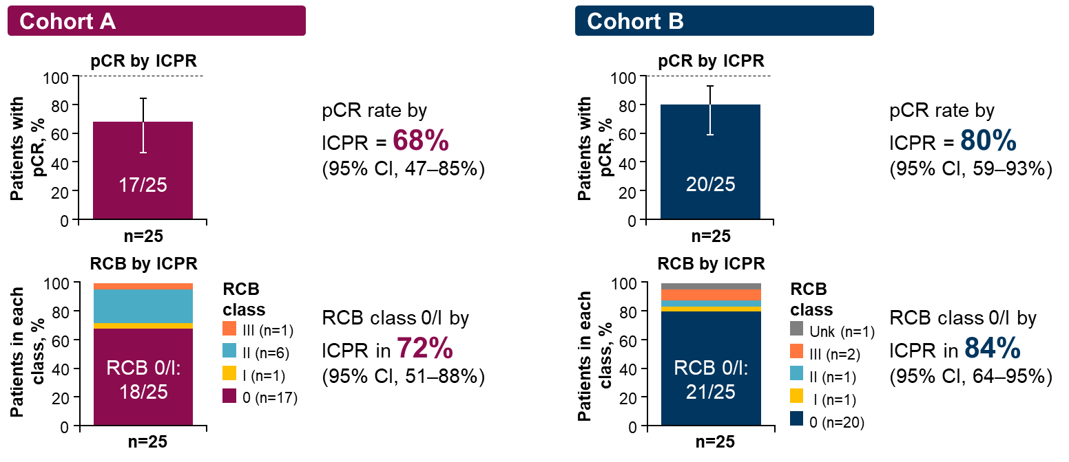
OlympiaN: Efficacy Outcomes
Notes:
So, if you look here at the results, so for cohort A, those patients with stage 1 disease who received olaparib, 68% got to pCR. Small number. There were only 25 patients in each arm, but this does show the value and the activity of this drug in a pretty impressive way.
And then, if you look at the cohort B, this is patients who received olaparib, durvalumab. You get an 80% pCR rate in those patients. And then, if you look at RCB class 0 to 1, so patients who had a little bit of residual disease, that was 84% of the patient population who really had quite a little bit of cancer left behind.
So, it definitely shows good efficacy in small numbers of patients. Maybe not ready for prime time yet, but definitely worthy of greater study. And I think in those patients who can't tolerate chemotherapy, this would be something I would consider pushing for. It definitely shows the activity of the drug.

Slide 46
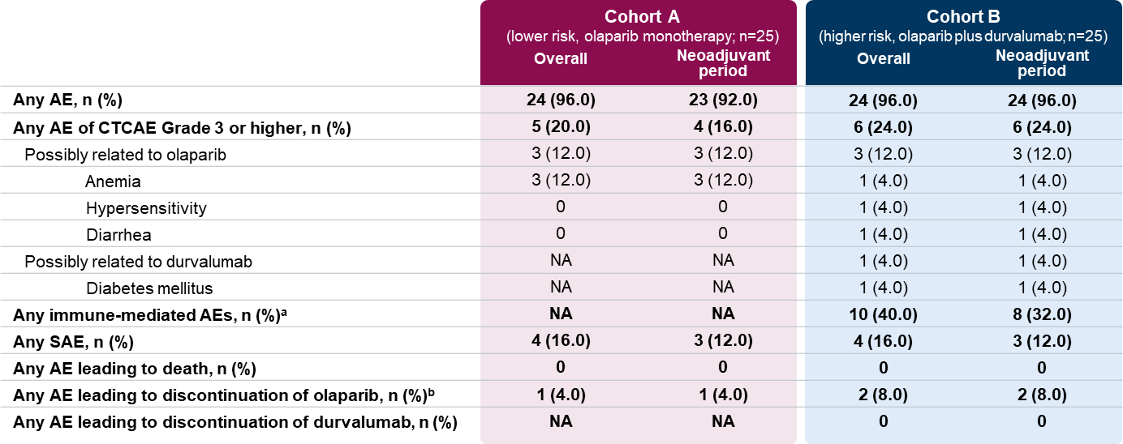
OlympiaN: Safety Outcomes
Notes:
So, in terms of adverse events, we could see that most of these adverse events were things like anemia a little bit of diarrhea, things like that. The diarrhea was much more often seen in the patients who received durvalumab. But again, was still only 4% of patients.
There was one patient in the durvalumab cohorts that had diabetes that was felt to be possibly related to the immunotherapy. But patients mostly did quite, quite well. There were no adverse events leading to death, thankfully, and then very few serious adverse events. So, these patients did quite well and also tolerate the treatment beautifully.

Slide 47
What is Shared Decision-Making?
Shared decision-making (SDM) occurs when a healthcare provider and
a patient work together to make a healthcare decision that is best for
the patient
Optimal decision-making takes into account evidence-based information about available options, the provider's knowledge and experience, and
the patient's values and preferences
Notes:
So, moving from treatment to shared decision-making. I think now that we have so many options for patients, it is really important for patients to understand what you're talking about, and also have the opportunity to express buy-in. So, shared decision-making occurs when the healthcare providers, us, and their patients work together to make healthcare decisions that are best for patients.
I think optimal decision making does take into account, of course, the evidence, which we all know well, our experience with drugs and with trials, and also the patient's values and preferences. I think it's really important, I feel, before we even go into a discussion of what are we recommending for you, to kind of understand where patients are coming from. I'll often ask questions like, after I've taken a full history, what else should I know about you in order to help you make good decisions? And I might also ask questions like, what do you know so far about what the treatment might look like for this cancer? I'd just like to know where you're coming from, so I can kind of meet you where you are.
But often those kind of more open-ended questions, both A; show that you care about who they are as a person, and then B; allow you to get really important information about what they think they do know so far, and what their feelings are about things like chemotherapy or genetic testing, or what in their own life might make things particularly hard for them or challenging about the treatment plan you're about to embark upon.

Slide 48
SHARE Approach to Shared Decision-Making
The SHARE Approach presents a 5-step process for SDM that includes exploring and comparing the benefits, harms, and risks of each option through meaningful dialogue about what matters most to the patient:
  Seek your patient's participation
  Help your patient explore and compare treatment options
  Assess your patient's values and preference
  Reach a decision with your patient
  Evaluate your patient's decision
Patients and their families/caregivers who are engaged in an SDM process are more likely to arrive at a treatment decision that works best for all those involved
Notes:
So, how to best do this. The SHARE approach is this 5-step process that I think – and these processes always feel a little bit stilted when you describe them, but I think you can definitely modify them to fit what feels most natural for you. But basically takes these 5 steps to explore and compare the risks and benefits of each option, and then talk to patients about what matters most to them.
So, the S is for seek your patient's participation. You want to bring them into the dialogue and make them know that they value and you value what they have to say. You want to help them explore and compare treatment options. And I think it is nice and important to present, there's not just one way to do this, here are the multiple ways. Here's why I might choose what I would choose if you kind of asked for that guidance But really assess – that's the third one, the assess – your patient's values and preferences. You then reach a decision with your patient after discussion, and then have opportunities to evaluate your patient's decision with them. You also want to make sure that they know that any decision they make is not usually irreversible. They can continue to talk that through with you. If they start a chemotherapy regimen and they really don't tolerate it, there are always opportunities to sort of backtrack or take a different approach as time goes on and to be flexible.
Data shows that patients and their families who are engaged in this shared decision-making are more likely to get to a treatment decision that works best for all of them and more likely to be able to sort of motivate to get through these complex treatments that we are now recommending.

Slide 49
Team-Based Practical Strategies in Surveillance and Management of Adverse Events

Slide 50
OlympiA: Common Adverse Events
Adverse Event | Olaparib (N = 911) |  |  |  | Placebo (N = 904)
 | No. of patients (%)
 | Any Grade | Grade 1 | Grade 2 | Grade ≥3 | Any Grade | Grade 1 | Grade 2 | Grade ≥3
Overall | 836 (91.8) | 211 (23.2) | 402 (44.1) | 223 (24.5) | 758 (83.8) | 268 (29.6) | 388 (42.9) | 102 (11.3)
Nausea | 520 (57.1) | 391(42.9) | 122 (13.4) | 7 (0.8) | 213 (23.6) | 187(20.7) | 26 (2.9) | 0 (0.0)
Fatigue | 367 (40.3) | 240(26.3) | 111 (12.2) | 16 (1.8) | 248 (27.4) | 188 (20.8) | 54 (6.0) | 6 (0.7)
Anemia | 215 (23.6) | 68 (7.5) | 68 (7.5) | 79 (8.7) | 35 (3.9) | 19 (2.1) | 13 (1.4) | 3 (0.3)
Vomiting | 206 (22.6) | 160 (17.6) | 40 (4.4) | 6 (0.7) | 74 (8.2) | 64 (7.1) | 10 (1.1) | 0 (0.0)
Headache | 180 (19.8) | 145 (15.9) | 33 (3.6) | 2 (0.2) | 152 (16.8) | 120 (13.3) | 31 (3.4) | 1 (0.1)
Diarrhea | 160 (17.6) | 125 (13.7) | 32 (3.5) | 3 (0.3) | 124 (13.7) | 96 (10.6) | 25 (2.8) | 3 (0.3)
Neutrophil count decreased | 147 (16.1) | 36 (4.0) | 66 (7.2) | 45 (4.9) | 59 (6.5) | 17 (1.9) | 35 (3.9) | 7 (0.8)
White blood cell count decreased | 144 (15.8) | 42 (4.6) | 75 (8.2) | 27 (3.0) | 52 (5.8) | 27 (3.0) | 22 (2.4) | 3 (0.3)
Decreased appetite | 119 (13.1) | 101 (11.1) | 16 (1.8) | 2 (0.2) | 53 (5.9) | 45 (5.0) | 8 (0.9) | 0 (0.0)
Dysgeusia | 107 (11.7) | 101 (11.1) | 6 (0.7) | 0 (0.0) | 38 (4.2) | 36 (4.0) | 2 (0.2) | 0 (0.0)
Dizziness | 104 (11.4) | 91 (10.0) | 12 (1.3) | 1 (0.1) | 66 (7.3) | 60 (6.6) | 5 (0.6) | 1 (0.1)
Arthralgia | 89 (9.8) | 64 (7.0) | 23 (2.5) | 2 (0.2) | 115 (12.7) | 91 (10.1) | 22(2.4) | 2 (0.2)
Notes:
So, some team-based practical strategies and surveillance and management of adverse events. We've talked a little bit about adverse events already, and this is just a slide looking at olaparib versus placebo in the OlympiA trial, that initial trial that looked at the year of adjuvant olaparib compared to placebo in patients who already received appropriate care for their breast cancer. You see that nausea and fatigue were much more significant in patients who received olaparib than patients who received placebo. Most of this was low-grade, but nausea and fatigue, even at low grade, can be really impactful in terms of everyday life.
Anemia is also a thing, and with anemia, of course, comes more fatigue. And then other side effects were pretty similar, headaches 19% versus 16%, decreased appetite was a little bit more prominent in the olaparib arm. But most of these side effects patients did feel were manageable.
So, I think it's important to sort of think about these things and make sure that you're preparing your patients for what they might experience on these medications, and of course, be following them closely to make sure that if side effects do come up, you can address them in ways that feel safe and helpful.

Slide 51
Management of Common Non-Hematologic AEs Associated With PARP Inhibitors
AE | Low-Grade Symptoms (or initial management) | High-Grade Symptoms (or follow-up management)
Nausea with or without vomiting | Do not replace vomited dose; take next dose at scheduled time Consider prophylactic metoclopramide 30-60 minutes before PARP inhibitor and taking with a light meal Treat gastroparesis and dyspepsia when indicated Consider antiemetics such as metoclopramide or a 5-HT3 antagonist for symptom management Consider taking PARP inhibitor later in the day (10 AM instead of 8 AM) for twice-daily dosing, or at night before bed for daily dosing | Dose interruption until AE resolves to grade 1 or less Exclude other causes (partial or complete bowel obstruction) Resume the same dose with prophylactic antiemetic therapy Dose reduction if AE recurs despite prophylactic therapy
Fatigue | Encourage a balance of physical activity and energy conservation; tailor realistic expectations with a structured daily routine Consider nonpharmacologic interventions (eg, massage therapy, psychosocial interventions) Optimize treatment for depression, sleep dysfunction, and nutritional deficit | Dose interruption until AE resolves to grade 1 or less Exclude anemia, electrolyte imbalance, or endocrine dysfunction as contributing causes Exclude depression as a contributor Resume the same dose or consider dose reduction if AE recurs despite supportive management
Notes:
So, nausea and fatigue are two of the most common side effects associated with PARP inhibitors. We're talking about non-hematologic side effects just because these are the ones that tend to affect patients' quality of life the most. So, this is just a little bit of a baseline guideline for how to manage these things. If patients have low-grade symptoms, you don't want to replace a vomited dose, but you do want to take the next dose at the scheduled time. And then, you can consider prophylactic medications such as metoclopramide 30 to 60 minutes before patients take a PARP inhibitor, so that things are moving through appropriately.
We often will prescribe things like ondansetron as well to help with symptom management. And then, patients can consider taking the pill later in the day for twice-daily dosing, or at night before bed if patients are taking the medication daily. And then for fatigue, this is a harder thing to medicate, of course. We often can optimize sleep management with our patients. We can treat depression. We can optimize nutrition and exercise. Typically, I don't recommend stimulants for patients who have fatigue on PARP inhibitors because it's one of those things where we’re not really sure that the stimulant is going to make that better, or if it does, it may come at some cost. So, there's really more lifestyle management, and then if fatigue is overwhelming, considering a dose reduction.

Slide 52
Management of Common Non-Hematologic AEs Associated With PARP Inhibitors
AE | Low-Grade Symptoms (or initial management) | High-Grade Symptoms (or follow-up management)
Anemia | Workup investigations to exclude other causes of anemia, including iron, vitamin B12, folate deficiencies, or hypothyroidism Consider a short period of dose interruptions without dose reduction | Dose interruption when Hb <8 g/dL and bloods should be monitored weekly until Hb returns to ≥9 g/dL Blood transfusion is recommended when Hb <7 g/dL or higher levels if symptomatic or significant comorbidities are present Once recovered, resume PARP inhibitor at the same or reduced dose level (if dose interruption took place because of symptomatic anemia) If AE not recovered after 4 weeks or repeated occurrence, the patient should be referred to a hematologist to exclude MDS/AML
Neutropenia | Observe asymptomatic cases | Dose interruption when the neutrophil count is <1.0 × 10⁹/L, and bloods should be monitored weekly until recovery Once recovered, resume PARP inhibitor at reduced dose level If AE is not recovered after 4 weeks or repeated occurrence, the patient should be referred to a hematologist to exclude MDS/AML
Thrombocytopenia | Review concomitant medications to exclude other causes of thrombocytopenia For niraparib: Ensure that weight-based dosing was used for those <77 kg; dose interruption when the platelet count is <100 × 10⁹/L, and bloods should be monitored weekly until the platelet count is ≥100 × 10⁹/L For olaparib and rucaparib: Dose interruption when the platelet count is <50 × 10⁹/L, and bloods should be monitored weekly until the platelet count is ≥100 × 10⁹/L | Platelet transfusion recommended when the platelet count is <10 × 10⁹/L or higher if bleeding or on anticoagulants For niraparib: Dose reduction if the platelet count falls to <75 × 10⁹/L or higher if bleeding For olaparib/rucaparib: Dose reduction if the platelet count falls to <50 × 10⁹/L or higher if bleeding If AE is not recovered after 4 weeks or repeated occurrence, the patient should be referred to a hematologist to exclude MDS/AML
Notes:
For anemia, neutropenia, and thrombocytopenia, these things are a little bit less gray because they are very well-defined by what the numbers look like. And you can see that for many patients, you do want to investigate, especially with anemia first, whether they could have a nutritional deficiency contributing or hypothyroidism. But certainly, if symptoms are higher grade or for these other cytopenias, you're probably going to end up doing some drug holds, some rechecking of labs before you get back to a dose that works for the patient.

Slide 53
Interprofessional Collaboration on Managing AEs
Management of toxicities in an interprofessional environment is critical to optimize success
Dose delays/reductions should be utilized as needed to allow patients to continue therapy
Practical strategies need to be developed to ensure patient safety and treatment adherence
Notes:
And I think interprofessional collaboration is really important. So, we want to be managing these toxicities together, making sure that we do utilize dose delays and dose reductions to help patients understand that we can help them feel better, that they don't have to stay on the full dose, and that we can have some be better than none. And then, we have to develop practical strategies to ensure that patients are feeling safe and that they are able to adhere to their treatment.
The other thing we didn't talk about yet is financial toxicity, but that certainly can be an issue too. Some insurance companies cover this more completely and patients may fall into like, donut holes of prescription drug coverage where the cost of the medication can be concerning. I think I find that it's so variable and sometimes patients don't want to talk about that stuff, and so I do say to people, really with any specialty drug, if we prescribe this pill and it's cost prohibitive, definitely let us know because we may not even know. And if you tell us, there may be things we can do about it, talking to the company, getting coupons, those kinds of things.

Slide 54
Practical Application: Case-Based Learning Lab

Slide 55
Case Study #1
55-YEAR-OLD WOMAN
Family history: Ovarian cancer in sister at age 47
Presents with a left breast mass
Biopsy: Adenocarcinoma, grade 3, ER 50%, PR 30%, Ki67 30%, HER2 1+
Genetic testing: BRCA2 mutation
Undergoes bilateral total mastectomy and left axillary dissection
Pathology: 2-cm ER+/PR+/HER2- IDC, 4/14 LN positive
Receives post-mastectomy radiation
Notes:
So, the first case is a 55-year-old woman. She has a family history of ovarian cancer and her sister at age 47. She herself is now presenting with a left breast mass. Her biopsy shows grade 3 adenocarcinoma. She's ER 50%, PR 30%, Ki-67 of 30%.
She has genetic testing and has a BRCA2 mutation that's found. Because of this, she opts to go with bilateral total mastectomy and left axillary dissection. She's found to have a 2-centimeter ER-positive, HER2-negative breast cancer with 4 out of 14 lymph nodes positive, so she meets the criteria for the OlympiA trial with those four positive nodes. She receives post-mastectomy radiation, but then you're thinking through with her, what do you want to do next?

Slide 56
Case Study #1: Polling Question
Other than anastrozole for at least 5 years, what else would you offer to this patient?
  No further therapy
  Capecitabine x 6 months
  Abemacicib x 2 years or ribociclib x 3 years
  Olaparib x 1 year
  Olaparib x 1 year, then abemaciclib x 2 years or ribociclib x 3 years
  Other
Notes:
So, other than anastrozole for at least 5 years, what else would you offer this patient? Would you offer her no further therapy, capecitabine for 6 months, abemaciclib for 2 years or ribociclib for 3 years, olaparib for 1 year, or olaparib for 1 year, then abemaciclib for 2 years, or ribociclib for 3 years, or would you do something else? And remember, this is a patient with 4 out of 14 positive lymph nodes, ER-positive breast cancer, and a BRCA2 mutation.
So, I think yeah, this kind of does highlight all the options that patients now have and also the importance of shared decision-making. So, this is a patient who's going to benefit from the anastrozole for at least 5 years for sure. I would not say no further therapy because she has so many other options. I also would not say capecitabine for 6 months because that would be really more for a patient with triple-negative disease and probably someone without a germline BRCA mutation, because for those mutation carriers, you're going to be thinking about olaparib.
For this patient, I definitely would want to give her olaparib for a year. With those four positive lymph nodes, she meets criteria for the OlympiA trial, and we have a clear benefit in these patients in terms of disease-free survival, distant disease-free survival, and even overall survival with the olaparib. And I think after the olaparib, it's really about pacing yourself. In patients with BRCA2 mutations and ER-positive disease and those four positive nodes, I do worry about recurrence. I do want to do everything I can within reason to reduce her risk of recurrence. So, I would probably start with the one year of olaparib along with endocrine therapy and after that, if the patient feels well enough and is ready for something more, that's where I would consider either the abemaciclib for 2 years or the ribociclib for 3.
She meets criteria for abemaciclib, and I think 2 years of treatment is often easier for patients than 3 years of additional, so I probably would start with the abemaciclib in her if she was willing to do a CDK4/6 inhibitor. But if diarrhea or something like that became prohibitive, she could always switch to the ribociclib.
I think, psychologically for patients, this can feel like a lot. It's a lot of pills, it's a lot of specialty drugs, a lot of potential side effects and lab draws.
So, I usually try to present this as if it's an opportunity, which it really is. It's an opportunity to optimize your cure rate. And if you can't do all of it, we understand that. It's not any fault of yours, it’s just that this is hard treatment. But these are all opportunities for you and we want to do everything we can to help you get through it. And that's kind of how I present it so that patients feel not like it's an obligation, but like it's sort of an opportunity, to optimize their rate of cure. And they know that if they kind of have a really difficult time tolerating some of these medications, that A: we can change things up if we have to, and B: that if they can't tolerate all of it and can't get through the whole thing, then that's okay So, I think that's sort of just common sense, supportive partnership with your patients when you're thinking about all these things if it makes sense.
But in terms of what I would want this patient to do in an ideal situation, it would be the anastrozole for 5 to 10 years, and that first year incorporating olaparib for the 12 months, and then add 2 years of a CDK 4/6 inhibitor, abemaciclib.

Slide 57
Case Study #2
45-YEAR-OLD WOMAN
Family history: Mother with breast cancer at age 40
Presents with 3-cm right breast mass, clinically node negative
Biopsy: Grade 3 adenocarcinoma, ER 0, PR 0, HER2 0
Gene panel testing: BRCA1 mutation (pathogenic)
Receives KEYNOTE-522 regimen (pembrolizumab x 4 Q3W + carboplatin/paclitaxel x 12 weekly, then pembrolizumab + AC x 4 Q3W)
Has bilateral total mastectomy
Pathology: 1-cm residual disease with 1/1 right axillary SLN positive
Notes:
So, this one is a 45-year-old woman, so younger Her mother had breast cancer at age 40. This patient is presenting with a 3-centimeter right breast mass. It's clinically node-negative, and her biopsy shows a grade 3 triple-negative breast cancer. She undergoes genetic testing very appropriately and is found to have a BRCA1 mutation, and she receives the KEYNOTE-522 regimen So, that’s pembrolizumab kind of all the way through 24 weeks, the first 12 weeks with carboplatin paclitaxel, and then– the second 12-week period of time receiving AC as well.
She undergoes a bilateral mastectomy and unfortunately, is found to have 1 centimeter residual disease and has one positive axillary node. So, that's unfortunate for this patient, but of course, you have options for her.

Slide 58
Case Study #2: Polling Question
What would be your approach for adjuvant therapy?
  Pembrolizumab x 9 cycles
  Pembrolizumab x 9 cycles + capecitabine x 6-8 cycles
  Pembrolizumab x 9 cycles + olaparib x 1 year
  Olaparib x 1 year
  Capecitabine x 6-8 cycles
  Other
Notes:
What would be your approach? Would you do pembrolizumab for 9 cycles? Would you do that pembrolizumab for 9 cycles followed by capecitabine? Would you do pembrolizumab for 9 cycles followed by olaparib or along with olaparib? Would you do just olaparib for one year? Would you do capecitabine for 6 to 8 cycles? Or would you do something else?
So, in terms of my approach to this, this is a patient where she did have some shrinkage, which is good, and you do want to reassure her that is a good thing because I do think that she still is probably likely to have a very good outcome and you don't want patients to be more afraid than they have to be. But you do want to explain that because she didn't get a complete response, she is higher risk for recurrence, and so we still do want to do more afterwards. And like with the positive patients, we now have opportunities for her that are more targeted that she can take advantage of to hopefully increase her cure rate.
So, these patients all should receive 9 cycles of pembrolizumab. That was what was included in the KEYNOTE-522 regimen as kind of a standard of care. And then if she didn't have the BRCA mutation, I would consider the capecitabine for 6 to 8 cycles or a clinical trial. But since she did have that, I would consider the olaparib for a year. And this is a patient who is going to benefit from radiation as well because she's got that positive lymph node, so mechanistically how I would do this is I would continue marching out the pembrolizumab, I would do the radiation therapy, and then the olaparib I would incorporate after the radiation is complete. So, the olaparib and the pembrolizumab would not overlap entirely, but probably the olaparib would get started as the pembrolizumab is winding down.

Slide 59
Case Study #2 (Cont’d)
45-YEAR-OLD WOMAN
The patient receives continued adjuvant pembrolizumab as well as adjuvant olaparib 300 mg twice daily
Three months into therapy, she complains of fatigue
Hemoglobin decreases to 8 g/dL from 12 g/dL at start of therapy
Notes:
So, continuing, this patient receives adjuvant pembrolizumab as well as adjuvant olaparib 300 twice a day. Three months into treatment, she complains of fatigue. Her hemoglobin decreases to 8 from 12, and so now you have to think about what to do for her. And it's one of these tricky things where the fatigue, of course, could be related to the drug. It also could be related to other things. The anemia, of course, could be related to the drug, and also there are other reasons why people sometimes have anemia.

Slide 60
Case Study #2: Polling Question
What would you do to manage her fatigue and anemia?
  Iron studies
  Give IV iron
  Bone marrow biopsy
  Blood transfusion
  Hold olaparib for 3-4 weeks, then restart at 200 mg twice daily
  Other
Notes:
So, would you either A: Do iron studies, B: Give IV iron, C: Do a bone marrow biopsy, D: Do a blood transfusion, E: Hold the olaparib and then restart at a lower dose, or other.
So, this is a case where this patient is fatigued and her hemoglobin has dropped significantly. She was completely normal at first at 12, and now she's at 8, which at our institution, unless you have like a major cardiac issue, which we're not seeing in this question stem, you probably wouldn't be transfusing her to hemoglobin of 8, but she is getting a little bit dangerously close. So, this is a situation where I would want to hold the olaparib, allow her counts to recover, and then consider restarting at the 200 milligram dose.
I probably, also in this case, in the real-world, would do iron studies as well as B12 and folate just because I would want to be kind of uncovering anything nutritional that I could fix. But I definitely wouldn't give either the iron or even consider a bone marrow biopsy unless either the iron studies showed low iron, in which case I probably would supplement oral iron first, and then as far as a bone marrow biopsy would go, you really wouldn't want to do that unless all cell lines were down and you really had a high suspicion for MDS, which would be extremely unusual for someone on one year of adjuvant olaparib. As we saw in the studies, we really didn't see increased rates of that compared to placebo in this trial. So, the answer here is probably hold the olaparib, then restart the lower dose once she recovers, and then potentially consider doing iron studies just to be complete.

Slide 61
Key Takeaways and Audience Q&A

Slide 62
Key Takeaways
Every patient newly diagnosed with EBC will likely receive a BRCA1/2 test
High-risk patients with BRCA-mutated HER2- EBC derive OS benefit from adjuvant olaparib
IDFS benefit is seen with adjuvant CDK4/6 inhibitors in HR+/HER2- EBC
  OS benefit is seen with adjuvant abemaciclib
  Adjuvant ribociclib trial is not powered for OS
pCR rate is improved by neoadjuvant pembrolizumab in HR+/HER2- EBC
EFS and OS are prolonged by neoadjuvant/adjuvant pembrolizumab in
early-stage TNBC
Notes:
So, moving on to some of the key takeaways. Every newly diagnosed early breast cancer patient these days will likely receive a germline BRCA test, particularly if they're HER2-negative and per ASCO if they're under 65, regardless. High-risk patients with BRCA-mutated, HER2-negative early breast cancer derive a benefit from adjuvant olaparib, not only in terms of progression-free survival, but also in terms of how long they live. We literally can cure more patients with this drug.
Invasive disease-free survival benefit is seen with adjuvant CDK4/6 inhibitors in patients who have hormone-positive, early-stage breast cancer. There's an overall survival benefit now that we see that's statistically significant with adjuvant abemaciclib. The adjuvant ribociclib trial was not powered for overall survival, so we have to be careful as we continue to interpret that data going forward.
We know that pCR rates are improved by neoadjuvant pembrolizumab in hormone-positive, HER2-negative early breast cancer. We still don't quite know how that correlates with event-free survival and actual outcomes, so we're not really using neoadjuvant pembro yet in hormone-positive disease, but we know that early-stage triple-negative breast cancer patients do benefit from receiving pembrolizumab in the neoadjuvant and adjuvant setting.

Slide 63
Key Takeaways (Cont’d)
How to choose adjuvant therapy in EBC with BRCA1/2 mutation?
In HR+/HER2- disease, olaparib can be given for a year prior to CDK4/6 inhibitor if residual disease is present after neoadjuvant chemotherapy
In TNBC, olaparib can be given together with pembrolizumab if residual disease is present after neoadjuvant pembrolizumab + chemotherapy
Biomarkers may help us in the future to determine the optimal treatment for individual patients
Notes:
How do we choose adjuvant therapy for patients with early-stage breast cancer who have BRCA mutations? We know that for hormone-positive breast cancer, olaparib can be given for a year prior to CDK4/6 inhibitors if residual disease is present after neoadjuvant chemotherapy. And for triple-negative, we can give olaparib with pembrolizumab if there's any residual disease after neoadjuvant chemoimmunotherapy.
I think it's very possible that biomarkers in the future may be able to help us determine the optimal treatments for individual patients.

Slide 64
Glossary
AE, adverse event
AESI, adverse event of special interest
AI, aromatase inhibitor
ALN, axillary lymph nodes
AML, acute myeloid leukemia
BICR, blinded independent central review
CT, chemotherapy
ctDNA/RNA, circulating tumor DNA/RNA
DDFS, distant disease–free survival
DRFS, distant recurrence–free survival
EBC, early breast cancer
ECOG PS, Eastern Cooperative Oncology Group performance status
ET, endocrine therapy
GnRH: gonadotropin-releasing hormone
HER2-: human epidermal growth factor receptor 2 negative
HR, hazard ratio
IDFS, invasive disease–free survival
HR+: hormone receptor positive
IDFS, invasive disease–free survival
ITT, intention to treat
MDS myelodysplastic syndrome

Slide 65
Glossary
N, node
NSAI, nonsteroidal aromatase inhibitor
ORR, objective response rate
OS, overall survival
PFS, progression-free survival
PK, pharmacokinetics
PRO, patient-reported outcome
PT, preferred term
Q3W, every 3 weeks
R, randomized
RECIST 1.1, Response Evaluation Criteria in Solid Tumours, version 1.1
RFS, recurrence-free survival
RIB, ribociclib
SOC, system organ class
STEEP, Standardized Definitions for Efficacy End Points
TNBC, triple-negative breast cancer
TRAE, treatment-related adverse event
TTR, time to response

